Slide 1

The Accountability Framework – SP04 Agents
June 2024
Notes:
Slide 1

Slide 2
Accountability Framework (AF) - Overview
What is the AF
To align and improve horizontal and vertical accountabilities to strive towards world-class Contact Centre operations that optimize service for Canadians and businesses
Each scorecard will be made up of
A set of measures, grouped across a number of categories
Documentation for the each applicable measure, including information on weights, targets, and diagnostic metrics
A set of complementary balanced scorecards, for each position in Contact Centre operations and functional direction that align behaviours to the Agency’s desired outcomes
Why do we need it

Slide 3
Accountability Framework - Measurement Categories
Measure category | Measures | RAC | Dir | AD | Manager | Team Leader | Agent
Productivity | Average Call Handle Time (ACHT) | ü | ü | ü | ü | ü | ü
 | Percentage of staff Achieving ACHT target | ü | ü | ü | ü | ü
 | Achieving Adherence to Schedule Results |  |  |  | ü | ü | ü
 | Percentage of staff Achieving Adherence to Schedule target |  |  |  | ü | ü
Quality | Average Accuracy Results | ü | ü | ü | ü | ü | ü
 | Percentage of staff Achieving Accuracy Target |  | ü | ü | ü | ü
 | Average Communications Results | ü | ü | ü | ü | ü | ü
 | Percentage of staff Achieving Communications Target |  | ü | ü | ü | ü
 | Average Policies and Procedures Results | ü | ü | ü | ü | ü | ü
 | Percentage of staff Achieving Policies and Procedures Target |  | ü | ü | ü | ü
 | Average Authentication Results | ü | ü | ü | ü | ü | ü
 | Percentage of staff Achieving Authentication Target |  | ü | ü | ü | ü
Financial | Budget Spend: Actual to Planned | ü | ü | ü
Behavioural | Average Behavioural Results |  |  |  |  |  | ü
 | Percentage of staff Achieving Behavioural Target |  |  |  | ü | ü
 | Projects |  |  |  | ü | ü
Customer Satisfaction | CSAT from POR | ü | ü | ü | ü | ü
 | Average CSAT score from IVR | ü | ü | ü | ü | ü | ü
 | % of staff achieving target average CSAT score from IVR |  | ü | ü | ü | ü
 | Rate of FCR | ü | ü | ü | ü | ü | ü
 | % of staff achieving target rate of FCR |  | ü | ü | ü | ü
Employee Satisfaction | ABSB contact centre staff satisfaction | ü | ü | ü | ü
 | Perm agent turnover | ü | ü | ü
 | Term agent turnover | ü | ü | ü
 | Unplanned absent to scheduled | ü | ü | ü | ü | ü
 | % of staff within acceptable range of absenteeism |  | ü | ü | ü | ü
Notes:
Items highlighted in blue apply only to Executives.
Customer Satisfaction/ Employee Satisfaction will not be part of the initial scorecard but will be assessed in future iterations.

Slide 4




Accountability Framework – Agent Measurement Categories
Quality
Productivity
Behavioural
Employee Satisfaction
Client Satisfaction
Are you offering good service?
Are you being efficient?
Are you respecting CRA core values?
Are employees happy?
Are clients happy?
Measures:
Achieving Accuracy, Authentication, Communications and Policies and Procedures Targets. (Agent results will be pulled from individual Quality Monitoring results)
Measures:
ACHT and
Adherence to schedule Targets
Measures (TBD):
Contributing to a positive work environment, works well with peers, tasks are completed on time; etc.
Future Development

Slide 5
Quality

Slide 6
Quality – Program Improvements to Quality Monitoring
Combine National and local quality programs into one national program
Increase listening to 8 calls per agent per fiscal period
Coaching moves from LQAP to :
Agent’s team leader for behavioural and soft skills
Qualifies SP-05s for technical items (likely facilitators)
Quality Evaluators will be partially on the phone to maintain skills and assist with peaks
Monthly calibration of quality evaluators
Refocus the measures to allow better coaching and service, include technical and soft skills
Agent and team leader will receive feedback for each call with a focus on critical errors
All call evaluations assigned by HQ team for arms length reviews (a national shelf)
Quality program changes will allow us to support the new accountability framework replacing the Contact Center Agent Assessment Tool (CCAAT) program (per commitment to the union in the latest round of collective bargaining).
Organization and Classification review in process for the Quality Evaluator and facilitator roles
* Quality will equate to 45% of the overall Agent Scorecard results.
Notes:
244

Slide 7
Productivity

Slide 8
Productivity – Adherence
Range for meeting a level 3 score will be 90% - 93%.
The percentage of the day during which the agent is adherent to their scheduled state.
Calculated by comparing agent’s real-time state to their scheduled state in Workforce Management (WFM).
Allowances have been made for activities beyond the agent's control.
Agents are responsible for adjusting their real-time state in WFM, and updating Traffic and Team Leads on major scheduling changes.
* Adherence will equate to 22.5% of the overall Agent Scorecard results.

Slide 9
Productivity – Average Call Handle Time (ACHT)
What is ACHT?
The average time that an agent spends on a call. It is made up of talk time, hold time, and wrap time.
For this purpose, we measure from an agent perspective:
Call begins when the Agent receives the call
Call ends when the Agent finishes their After Call Work (wrap) for that call
Average is calculated in the expected way:
Total Call Handling Time
Divided by the number of Calls
Target ACHT for each categorization is based on the previous Monthly Fiscal Period (FP) ACHT
Measured based on Skill and Call count threshold:
Skill - determined by the training an agent has received.
Call count threshold – broken down into agents that have answered less than 500 calls, and agents that have answered more than 500 calls, per skill.
Agents will be expected to achieve the target ACHT for the calls that they answer during the period, based on their skills
Quick calls and quick transfers are not included in the calculations. Calls that are included are classified as ‘qualifying calls.’
* ACHT will equate to 22.5% of the overall Agent Scorecard results.
Notes:
Slide 9

Slide 10
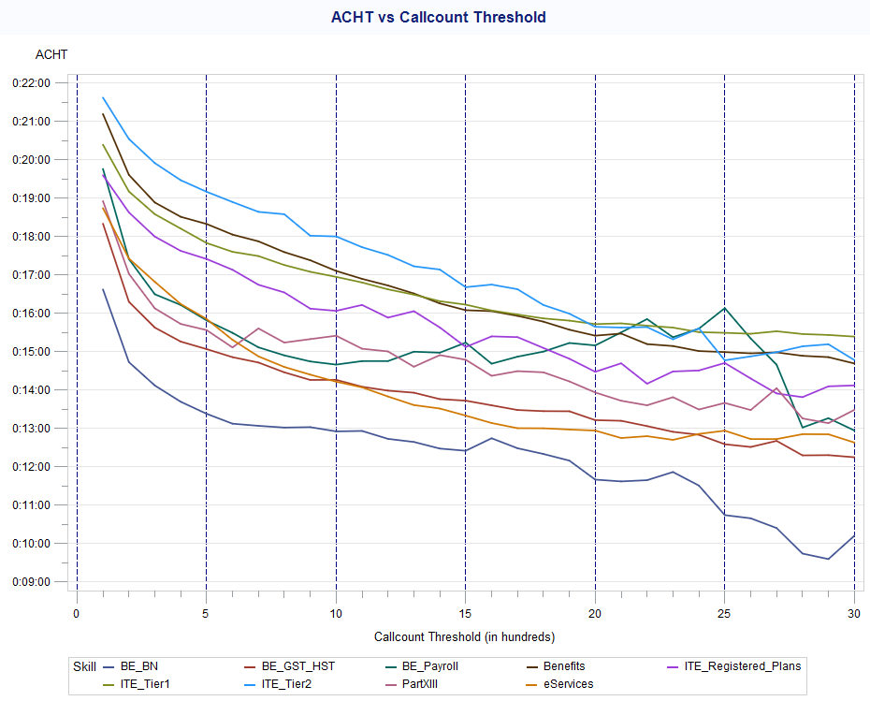
Productivity – ACHT Methodology – Determining Callcount Threshold
Call count Threshold of 500 is used as the separator for experience on a skill
Data from February 2021 – April 2024
ACHT declines rapidly on first 200-300 calls
Most skills linearly decline after 500 calls
ACHT declines less rapidly on most skills between 300-500 calls

Slide 11
Productivity – ACHT Methodology – Weighted Scoring
For each score, on each categorization, for each Agent:​
Multiply by the previously calculated Percent of Qualifying Calls:​
(Categorization Score) x (Percent of Qualifying Calls)​ – e.g. 3 x 34%
Defined as Portion of Score​ – e.g. 1.021653543
For each Agent:​
Add up all Portion of Score values​
SUM(Portion of Score)​ – e.g. 3.458661417
Round to nearest tenth (one decimal place)​
Defined as ACHT Score – e.g. 3.5
FP​ | Skill​ | Callcount Threshold​ | Total Calls​ | Quick Calls​ | Qualifying Calls​ | Agent ACHT​ | Target ACHT​ | Categorization Score​ | Percent of Qualifying Calls​ | Portion of Score​ | ACHT Score
P12​ | ITE_Special06​ | UNDER500​ | 36​ | 4​ | 32​ | 00:14:59​ | 00:16:39​ | 3​ | 6%​ | 0.188976378 ​
P12​ | ITE_Tier1​ | OVER500​ | 177​ | 4​ | 173​ | 00:13:41​ | 00:14:34​ | 3​ | 34%​ | 1.021653543 ​
P12​ | ITE_Tier1​ | UNDER500​ | 78​ | 2​ | 76​ | 00:11:22​ | 00:17:08​ | 4​ | 15%​ | 0.598425197 ​
P12​ | eServices​ | OVER500​ | 36​ | 1​ | 35​ | 00:18:33​ | 00:13:20​ | 2​ | 7%​ | 0.137795276 ​
P12​ | eServices​ | UNDER500​ | 201​ | 9​ | 192​ | 00:13:30​ | 00:17:05​ | 4​ | 38%​ | 1.511811024 ​
P12​ | ALL​ | Total​ | 529​ | 21​ | 508​ | 00:13:41​ |  |  | ​ | 3.458661417 ​ | 3.5
Notes:
Slide 12

Slide 12
Behavioural

Slide 13
Behavioural Assessment Tool – Agent Information Gathering
The Behavioural Assessment Tool will allow Team Leaders to capture off the phone behaviours that are exhibited by their agents, that are not captured through productivity results or quality evaluations.
The TL will complete this assessment for each assessment period. The tool will measure on the following:
Ownership of Duties and Responsibilities
Appropriately prioritizes work, seeking guidance when necessary
Contributes to a positive work environment
Works well with peers, clients and others
Contributes to an environment of continuous improvement
* Behavioural Assessment will equate to 10% of the overall scorecard results.
Notes:
Slide 16
This will be done through an assessment which will be completed by the TL for each assessment period.

Slide 14

Scorecard

Slide 15
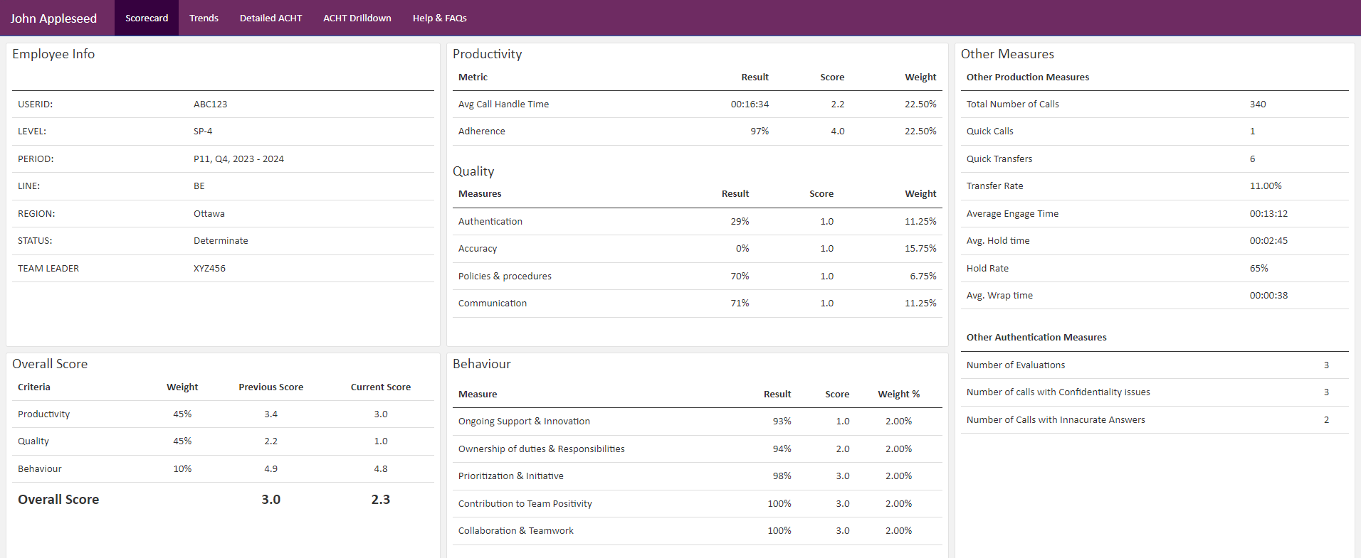
Accountability Framework - Scorecard
The scorecard is designed to provide contact centre employees with a comprehensive view of their performance across key measurement categories such as productivity, quality and behaviour.
Notes:
Slide 5

Slide 16
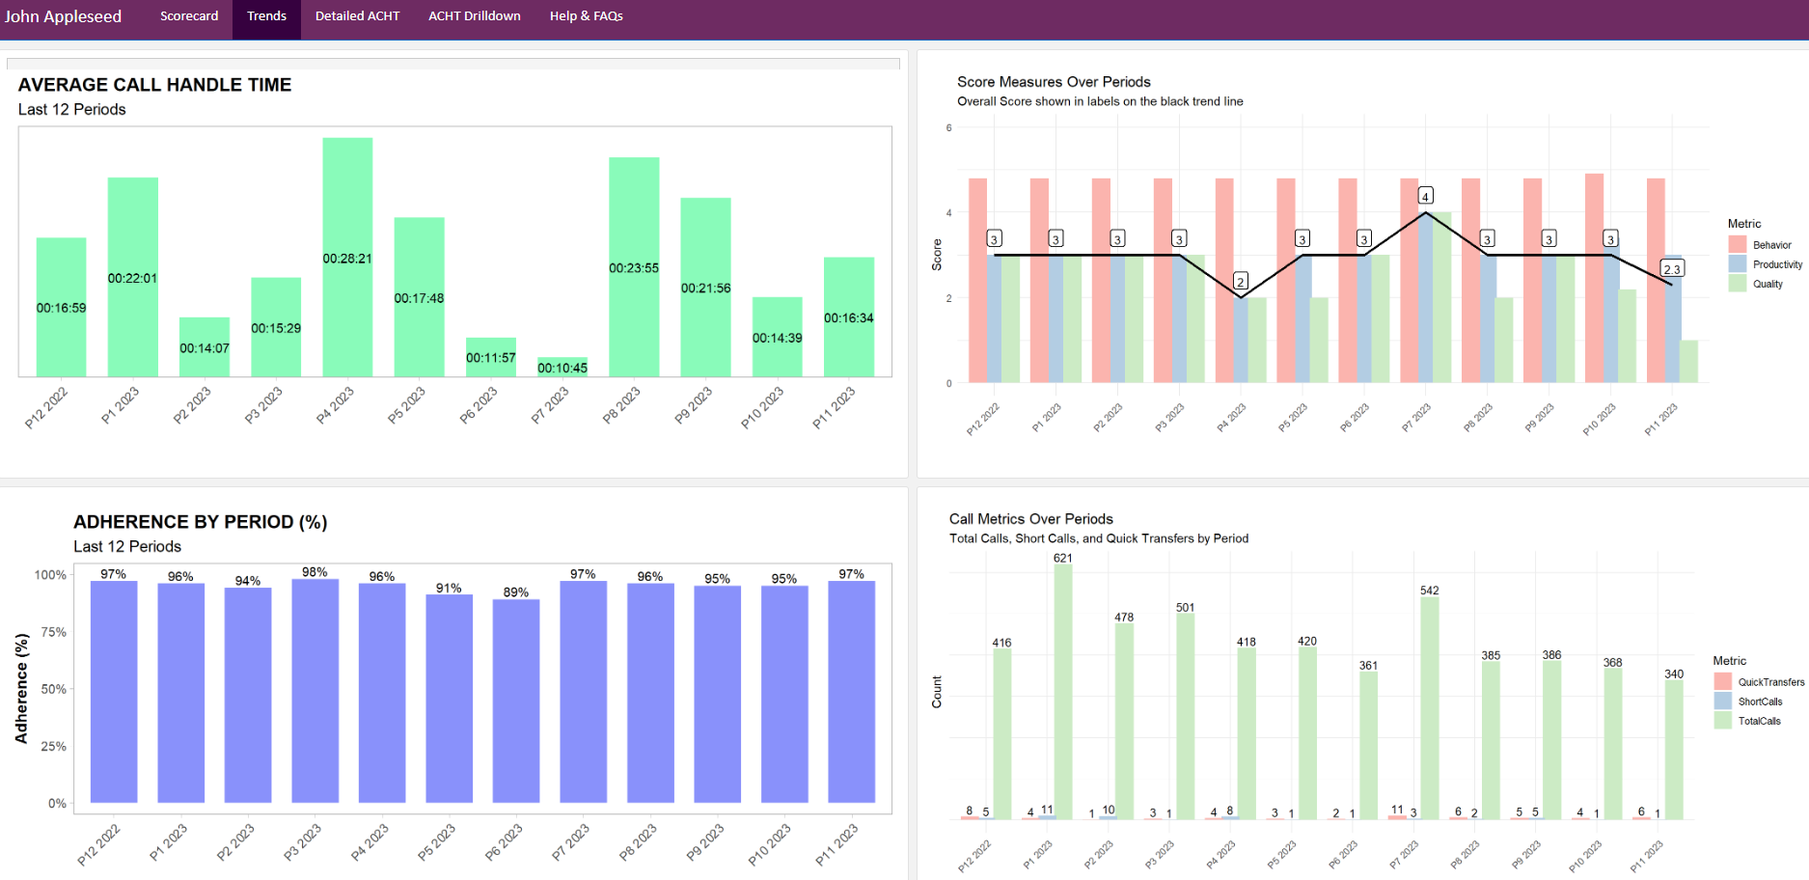
Accountability Framework - Scorecard
The trends page shows a historical view of the previous 12 fiscal periods which indicates the agent’s performance over time (the ACHT diagram will be removed as we have included data on slide 17).
Notes:
Slide 5

Slide 17
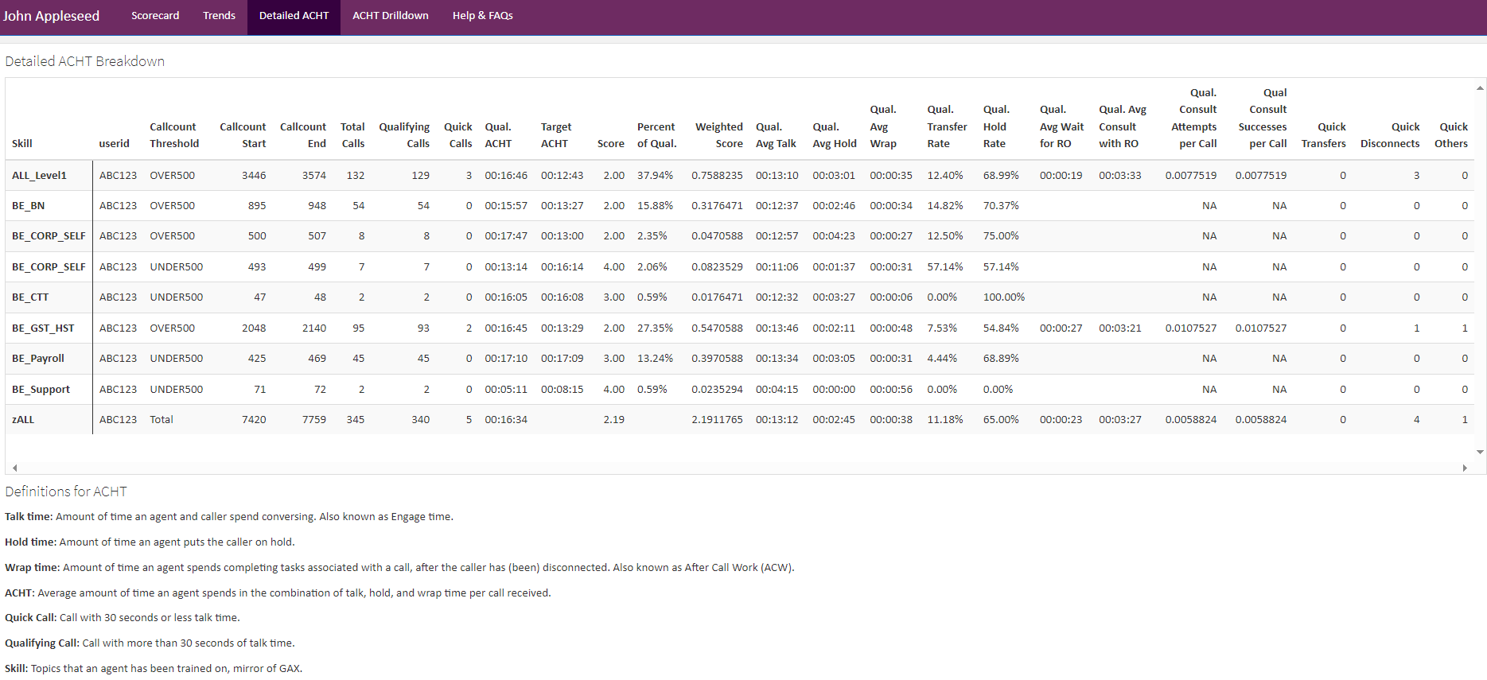
Accountability Framework - Scorecard
The Detailed ACHT is a breakdown of the ACHT measure on the first page which shows how the score was achieved without having to pull numerous reports.
Notes:
Slide 5

Slide 18
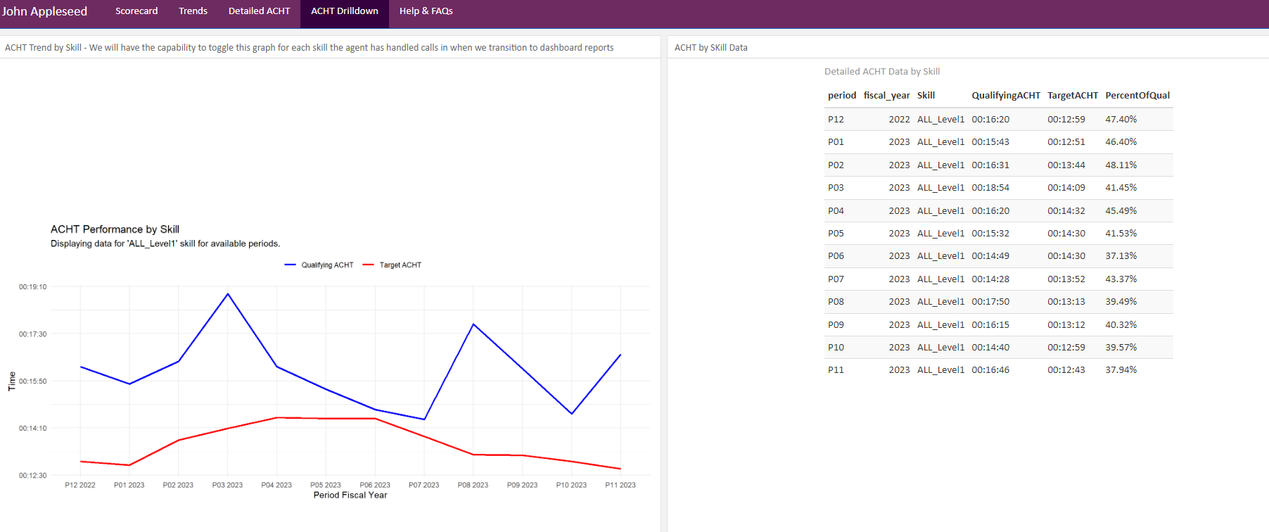
Accountability Framework - Scorecard
The ACHT Drilldown shows the agent’s ACHT relative to the target ACHT. At a glance TLs could identify if an agent is struggling and for how long. The ACHT by skill data shows the same information, just in table format.
Notes:
Slide 5

