Slide 1
Federal Public Service Workplace Mental Health Dashboard
Presentation to: Union of Tax Employees
National Health and Safety Conference
Date: November 1, 2024

Slide 2
Outline
What is it?
Why was it developed?
How was it developed?
Contact
What does it tell us?
What do the tabs produce?
Demonstration (some key results)

Slide 3
Introduction – What is it?
The Federal Public Service Workplace Mental Health Dashboard is:
a Power BI tool that provides scores for psychosocial factors outlined in the National Standard of Canada for Psychological Health and Safety in the Workplace (Annex A)

Slide 4
Objectives – Why was it developed?
Developed to…
Allow deputy heads to track their organization’s progress in addressing risk factors and support their implementation of the Federal Public Service Workplace Mental Health Strategy (the Strategy)
Support organizations in measuring strengths and gaps regarding psychological health and safety
Ensure consistency across departments
Reduce duplication and associated burden and cost

Slide 5

Development – How was it developed?
The key players
The process (conducted originally in 2020-21 and again in 2023-24)
Interdepartmental Committee on Workplace Mental Health Performance Measurement
Treasury Board of Canada Secretariat (OCHRO)
Statistics Canada
Public Services and Procurement Canada
Conceptual mapping of the Public Service Employee Survey (PSES) to the 13 factors in the National Standard conducted by expert panel.
Statistical analysis to validate the conceptual mapping using raw scores (1-5). Scores transformed afterward to be out of 100.
Reference: Blais, A-R., Michaud, I., Simard, J-F., Mach, L. and Houle, S. (2021). Measuring Workplace Psychosocial Factors in the Federal Government, Health Reports, 32(12). https://www150.statcan.gc.ca/n1/pub/82-003-x/2021012/article/00001-eng.htm

Slide 6
Results – What does it tell us?
Scores for psychosocial factors based on 2019, 2020 and 2022 PSES data
Enterprise-wide | Department level | Sub-organizational unit level
Disaggregation*
Demographic | Organization type
11 out of 13 factors measured:
Psychological support added in 2024 update (results available for 2020 and 2022)
Factors not measured:
Psychological competencies and requirements
  No PSES questions conceptually linked
Engagement
  Statistical testing did not validate measurement
*Consult Annex B for a list of demographic and employment categories

Slide 7



What do the tabs produce?
Results with Parent Unit Benchmark
Multi-level Comparison
Select Demographics
All Demographics
Trend over Time​
Interdepartmental Comparison
Intradepartmental Comparison
​​
​

Slide 8
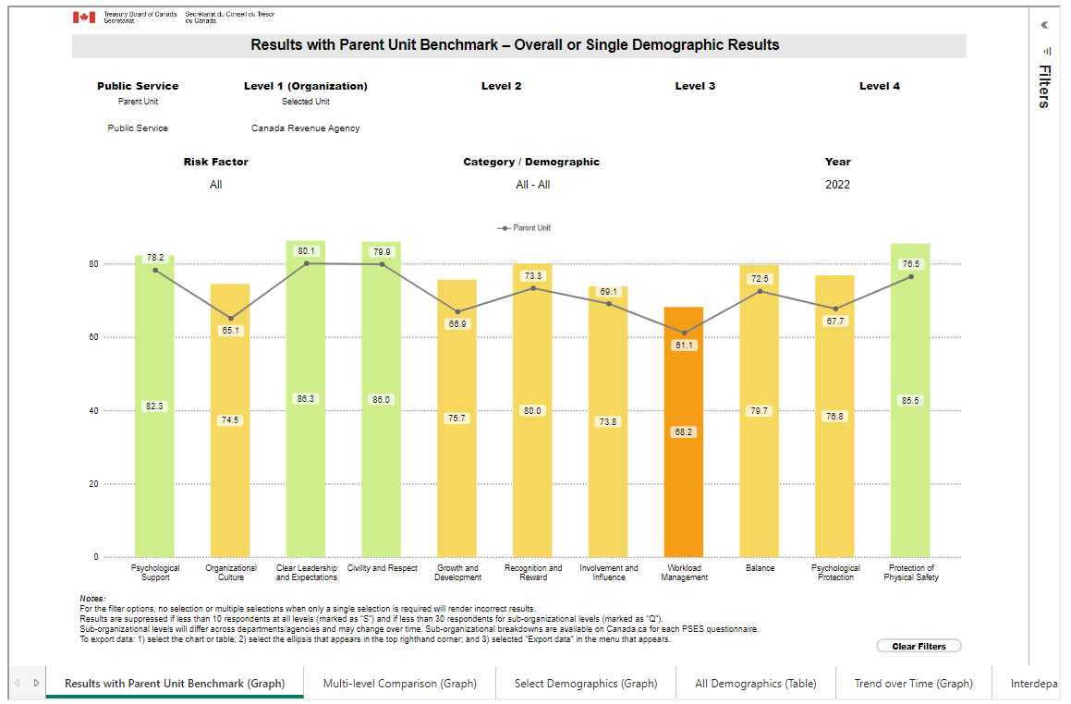
Key Results – Results with Parent Unit Benchmark (CRA compared to Public Service)
Graph explanation
The graph displays a comparison of CRA scores with the public service average across 11 psychosocial factors in 2022. CRA’s results are shown in a heat map format with green highlighting strengths and orange indicating areas for improvement, while the grey line represents the public service average trendline for reference.
Analysis
CRA significantly outscores the public service average (i.e., between 4 and 9 percentage points higher) on all 11 factors by at least four percentage points. Like the public service, CRA scores highest on Clear Leadership and Expectations and Civility and Respect, and lowest on Workload Management.

Slide 9
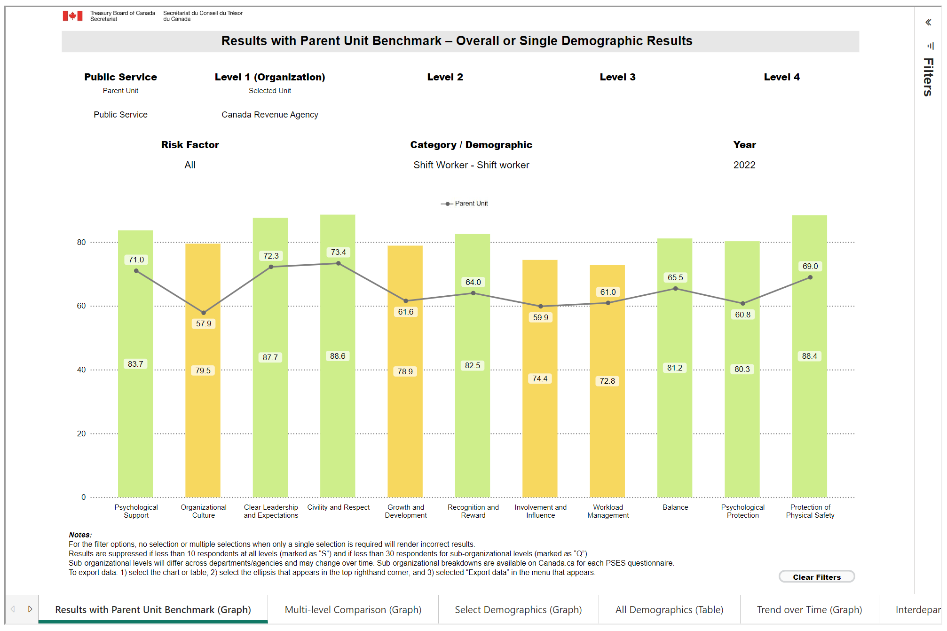
Key Results – Results with Parent Unit Benchmark (Shift workers at CRA compared to Public Service)
Graph explanation
The graph displays a comparison of shift workers at CRA compared to shift workers in the public service across 11 psychosocial factors in 2022. CRA’s results are shown in a heat map format with green highlighting strengths and yellow indicating areas for improvement, while the grey line represents the public service average trendline for reference.
Analysis
Scores for shift workers are much higher at CRA than on average across the public service for all 11 factors, by 12 percentage points (pp) and more. Gaps are especially pronounced for Organizational Culture (over 21 pp), Psychological Protection and Protection of Physical Safety (both over 19 pp).

Slide 10
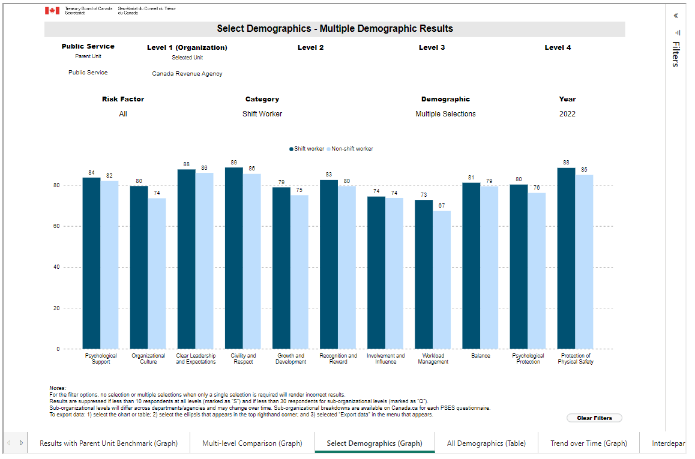
Key Results – Select Demographics (comparing shift workers and
non-shift workers within CRA)
Graph Explanation
The graph displays a comparison between CRA employees that are shift workers and non-shift workers for the 11 psychosocial factors in 2022. Shift worker scores are reflected in dark blue and non-shift worker scores in light blue.
Analysis
Shift workers score higher than non-shift workers on all the factors, though mostly by a relatively small margin (i.e., 3 percentage points or less). The difference in scores is more pronounced for Organizational Culture, Workload Management, Psychological Protection and Growth and Development.

Slide 11
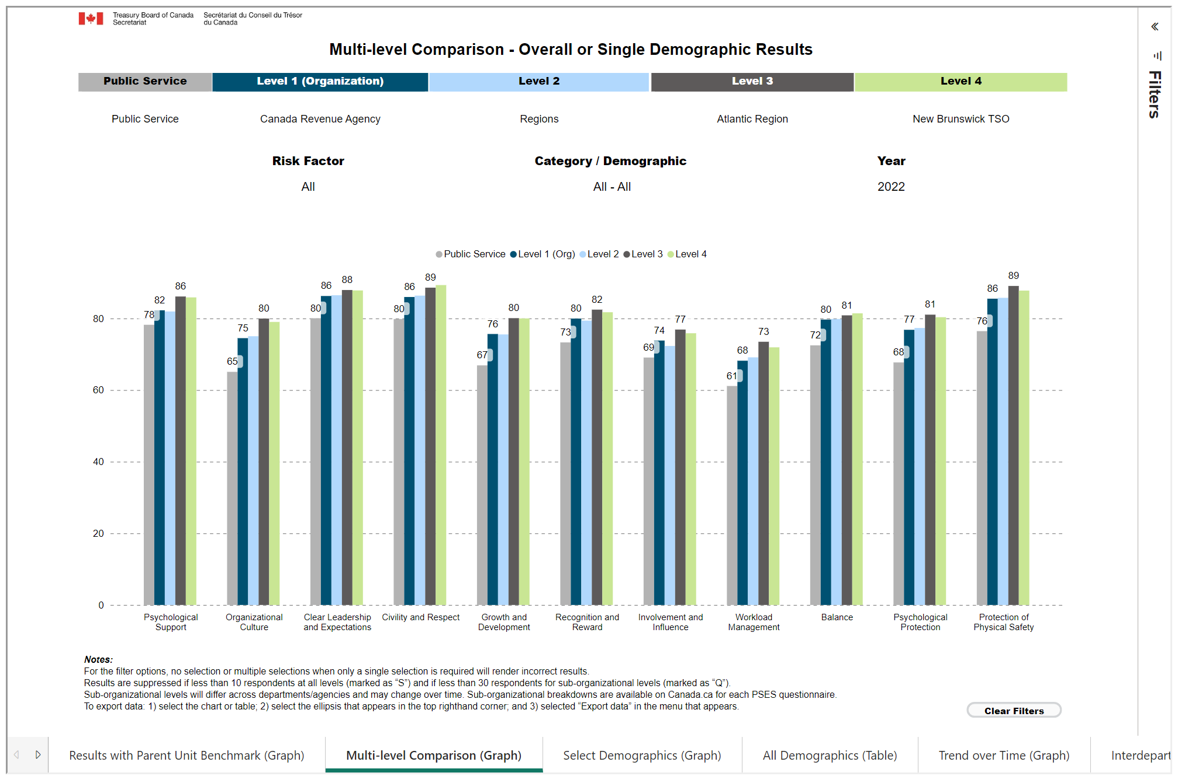
Key Results – Multi-level Comparison (New Brunswick TSO compared to levels above)
Graph Explanation
The graph displays a comparison across a range of levels, from the public service to the New Brunswick TSO, for the 11 psychosocial factors in 2022. The bars correspond with headings at the top of the graphic (i.e., public service in grey, CRA in navy, Atlantic Region in brown, and New Brunswick TSO in green).
Analysis
New Brunswick TSO and the Atlantic Region have similar scores, which are higher on all 11 factors than the other three levels. CRA and the Regions also have similar scores, which in turn are higher than the public service average on all 11 factors. The gaps between the Atlantic Region and the rest of CRA is most pronounced for Organizational Culture.

Slide 12
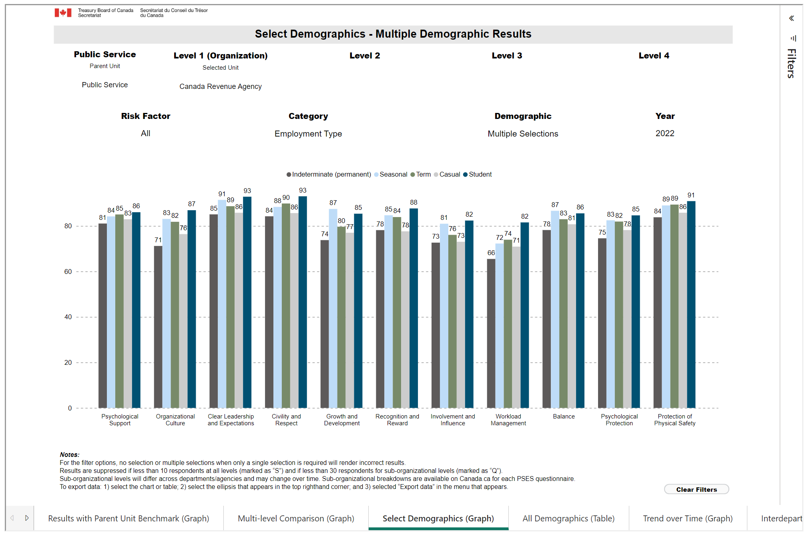
Key Results – Select Demographics (comparing Employment types within CRA)
Graph Explanation
The graph displays a comparison based on employment type of CRA employees for the 11 psychosocial factors in 2022. Indeterminate scores are reflected in brown, seasonal scores are in light blue, term scores are in green, casual scores are in grey, and student scores are in dark blue.
Analysis
Indeterminate employees score lowest on all factors and students score highest on most factors (9 out of 11). Seasonal employees score highest on Growth and Development and Balance. While seasonal employees generally score higher than term employees, the latter have slightly higher scores on Psychological Support, Civility and Respect, Workload Management and Protection of Physical Safety.

Slide 13
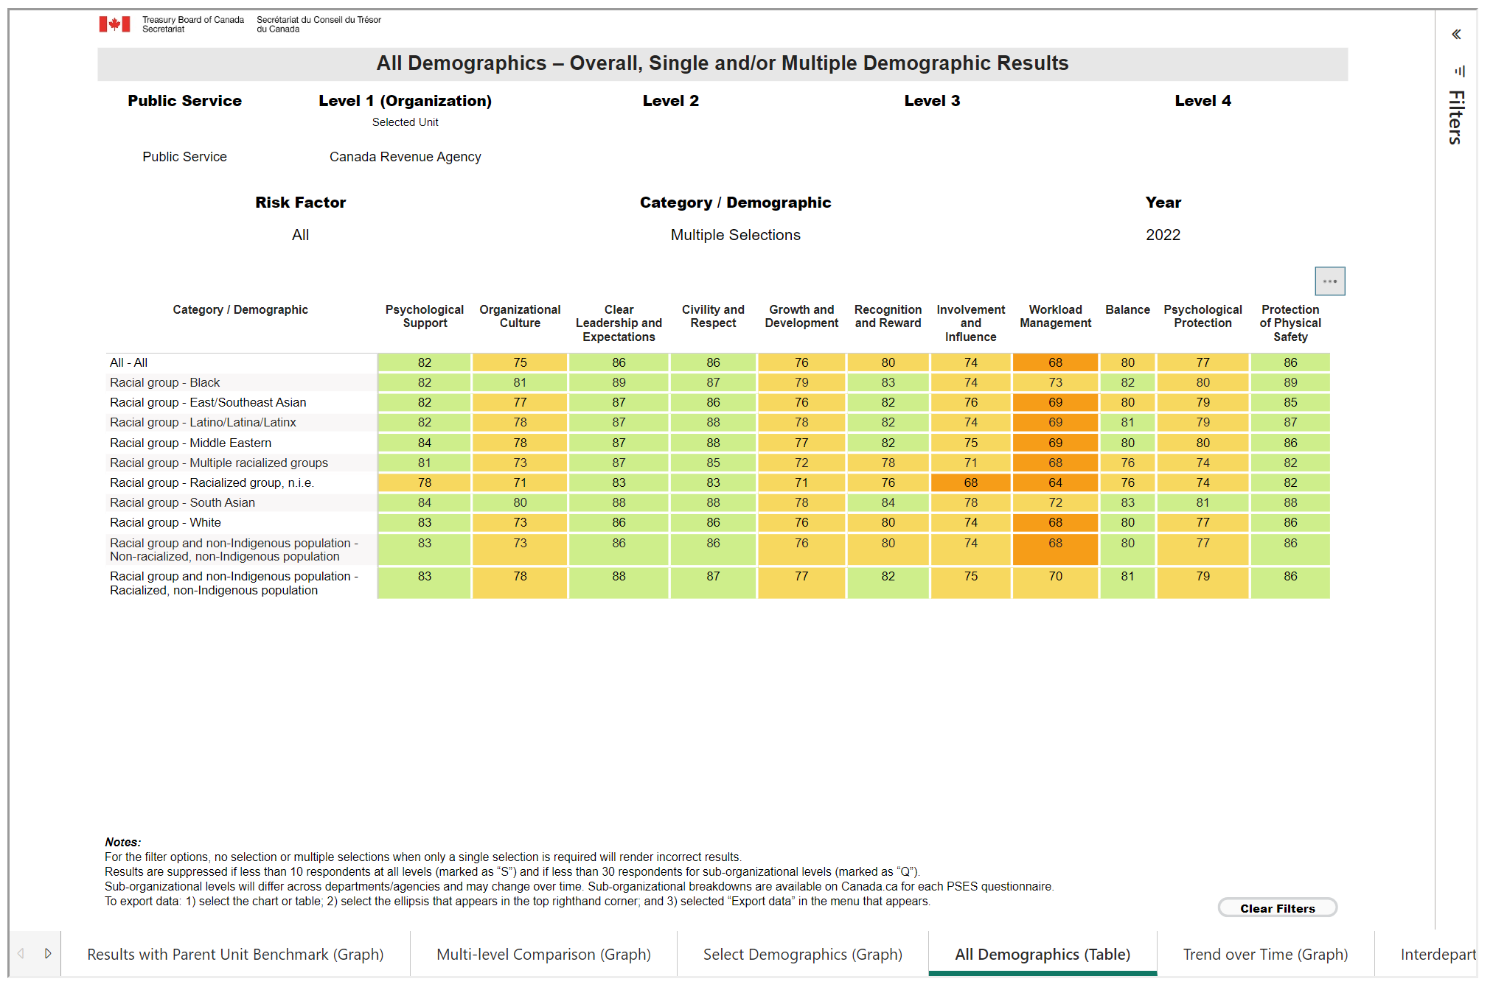
Key Results – All Demographics (comparing Racial groups within CRA)
Table explanation
The table displays a comparison of CRA scores for racial groups across 11 psychosocial factors in 2022. Results are shown in a heat map format with green highlighting strengths and orange indicating areas for improvement.
Analysis
All racial groups score high for Clear Leadership and Expectations, Civility and Respect and Protection of Physical Safety. Racialized, non-Indigenous employees score higher than non-racialized, non-Indigenous employees on all psychosocial factors, except Psychological Support and Protection of Physical Safety, where they score the same. The largest gap between the two groups is in Organizational Culture. Among racial groups, overall, Black and South Asian employees have the highest scores. Employees from multiple racialized groups and from a racialized group n.i.e. have the lowest scores.

Slide 14
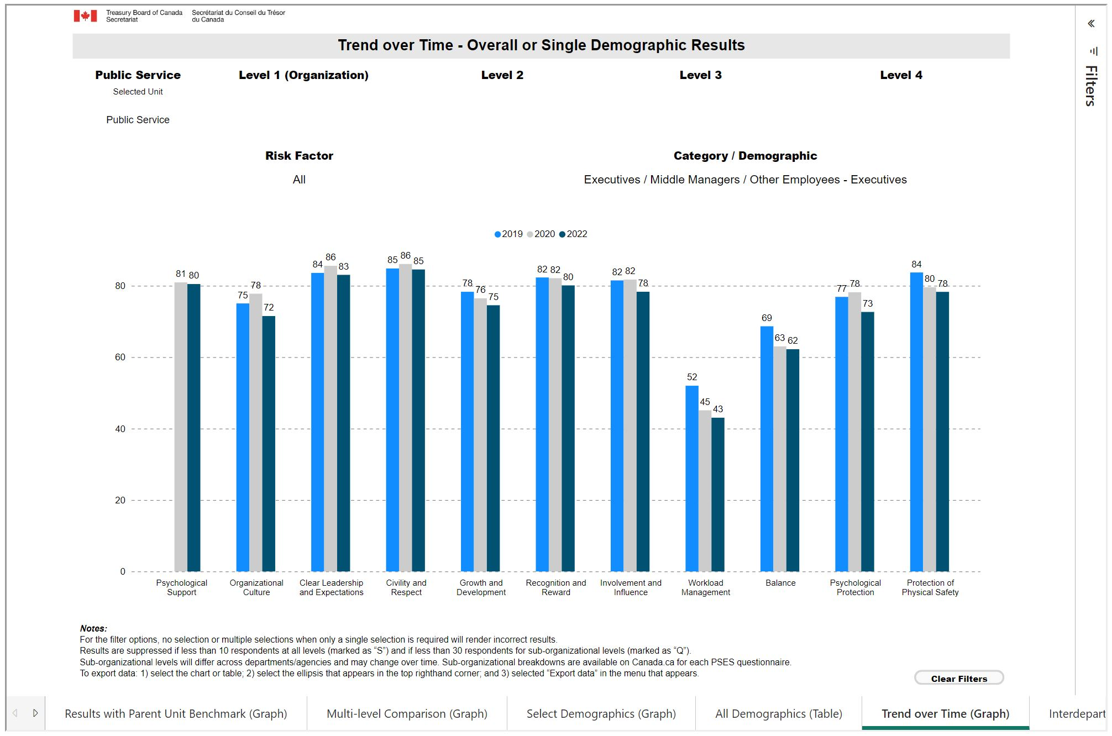
Key Results – Trend over Time (Executives in Public Service)
Graph explanation
The graph displays a comparison over time of scores for executives across the public service for 11 psychosocial factors. Graph results correspond with the colours indicated by the year above it (2019 in light blue, 2020 in grey and 2022 in dark blue).
Analysis
Scores indicate a downward trend for most psychosocial factors, with the sharpest declines in Workload Management, Balance and Protection of Physical Safety, respectively 9, 7 and 6 percentage points lower in 2022 than in 2019. The decline in Workload Management is particularly noteworthy given how low the score was already in 2019.
Note: results for Psychological Support are only available for 2020 and 2022, as the questions on which they are based were introduced in the 2020 PSES.

Slide 15
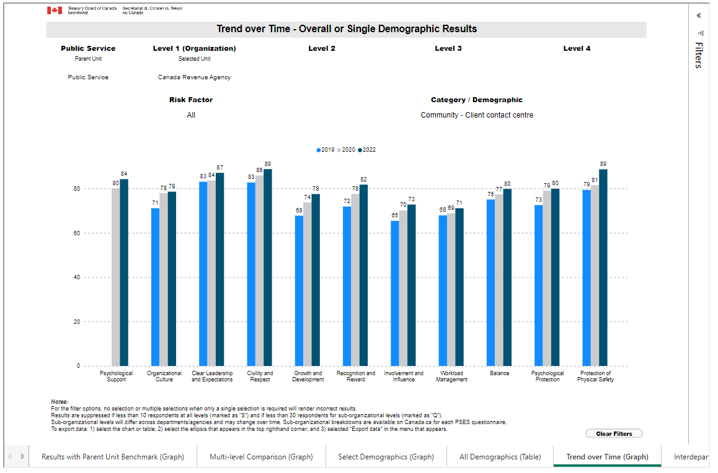
Key Results – Trend over Time (Client contact centre employees in CRA)
Graph explanation
The graph displays a comparison over time of scores for Client contact centre employees across CRA for 11 psychosocial factors. Graph results correspond with the colours indicated by the year above it (2019 in light blue, 2020 in grey and 2022 in dark blue).
Analysis
Scores indicate an upward trend for all psychosocial factors, with the sharpest increases in Growth and Development, Recognition and Reward and Protection of Physical Safety, all 10 percentage points higher in 2022 than in 2019.
Note: results for Psychological Support are only available for 2020 and 2022, as the questions on which they are based were introduced in the 2020 PSES.

Slide 16
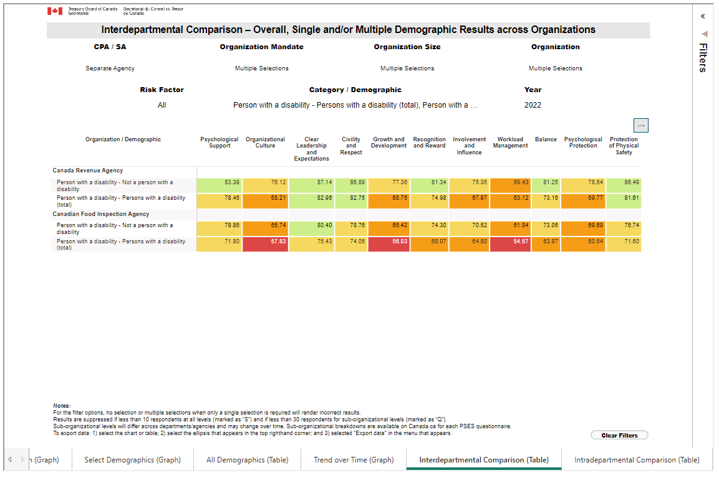
Key Results – Interdepartmental Comparison (results for Persons with a disability)
Table explanation
The table displays a comparison of scores for persons with a disability (PWD) in separate agencies under the Enforcement and Regulatory mandate, large and very large organizations only, across 11 psychosocial factors in 2022. Results are shown in a heat map format with green highlighting strengths and red indicating weaknesses.
Analysis
In 2022, scores for PWD were much lower than for non-PWD in both organizations across all factors. The largest gaps in scores between PWD and non-PWD employees at CRA were in Psychological Protection and Growth and Development. However, PWD in CRA had much higher scores than PWD in the Canadian Food Inspection Agency (CFIA) across all factors, except for Involvement and Influence, where the score for CRA PWD was only 3 percentage points higher than for CFIA PWD.

Slide 17
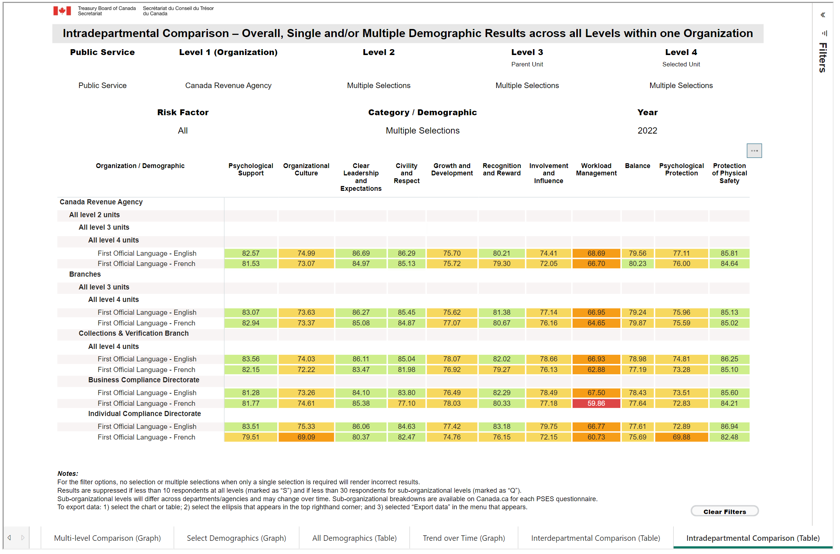
Key Results – Intradepartmental Comparison (Official Language results)
Table explanation
The table displays official language scores for two directorates in the Collections and Verifications Branch across 11 psychosocial factors in 2022. The organization structure is shown in a dropdown of each level selected (CRA, Branches, Collections and Verifications Branch, Directorates). Results are shown in a heat map format with green highlighting strengths and red indicating areas for improvement.
Analysis
At CRA, in its Branches, and in the Collections & Verification Branch in particular, scores by OL are generally slightly higher for anglophones. The picture is more varied in the directorates. In the Business Compliance Directorate, francophones score markedly lower than anglophones on Workload Management and Civility and Respect, but score higher, though only slightly, on several factors. In the Individual Compliance Directorate, anglophones score higher across the board, with sizable gaps on numerous factors.

Slide 18

Contact
GCMentalHealth@tbs-sct.gc.ca
Intranet.Canada.ca/GCMentalHealth
Canada.ca/GCMentalHealth
GCExchange

Slide 19

Annex A – National Standard of Canada for
Psychological Health and Safety in the Workplace
Image description: Title page of the National Standard Canada for
Psychological Health and Safety in the Workplace
A voluntary set of guidelines, tools and resources for organizations to systemically promote mental health and prevent psychological harm
13 psychosocial factors
1. Psychological support | ​8. Involvement and influence
2. Organizational culture | 9. Workload management
3. Clear leadership & expectations | 10. Engagement​
4. Civility and respect | 11. Balance​
5. Psychological competencies & requirements | 12. Psychological protection​
6. Growth and development | 13. Protection of physical safety
7. Recognition and reward

Slide 20
Annex B – Disaggregation: Demographic and Employment Categories
Gender, 2SLGBTQIA+ and Age
Official Language and Province or Territory of Work
Indigenous Peoples, Persons with Disabilities and Racial Groups
Employment Type, Location, Tenure and Schedule
Employment Role and Characteristics
Organization Characteristics

