Slide 1
Roles and Responsibilities of an Effective Health & Safety Committee
UTE
November 2024
Andrea Peart
National Health & Safety Officer

Slide 2
The Internal Responsibility System
The CLC is founded on the principal of Internal Responsibility
Provides 3 Basic Rights
  Right to Know
  Right to Participate
  Right to Refuse
The Internal Responsibility System
Places the direct responsibility for workplace health and safety on everyone in the workplace.
  Provides formal and informal mechanisms for raising OHS issues

Slide 3
Limitations of the IRS
  It is a closed loop
  You have to “play the game” before you can bring in a HSO if/when the parties disagree.
  You have to conduct “reasonable discussions” to reach “reasonable results” in a joint employee-employer committee.
  What if the employer reps simply say no all the time?

Slide 4

H&S Law in Canada – The Truth
  The most important tool for exercising worker rights is the Policy and Workplace Health and Safety Committees.
  Union involvement on these committees will have a direct impact on the health and safety of all workers.

Slide 5
What does a health and safety committee do?
Recognize workplace hazards
Evaluate the hazards and risks that may cause incidents, injuries, and illness
Make recommendations to management for incident prevention and safety program activities
Participate in the development and implementation of programs to protect the workers' safety and health
Respond to worker complaints and suggestions concerning safety and health
Ensure the maintenance and monitoring of injury and work hazard records
Monitor and follow up hazard reports and recommend action
Set up and promote programs to improve worker training and education
Participate in health and safety inquiries and investigations, as appropriate
Consult with professional and technical experts
Participate in resolving workplace refusals and work stoppages
Monitor the effectiveness of safety programs and procedures

Slide 6
What does a health and safety committee do?
Recognize workplace hazards
Evaluate the hazards and risks that may cause incidents, injuries, and illness
Make recommendations to management for incident prevention and safety program activities
Participate in the development and implementation of programs to protect the workers' safety and health
Respond to worker complaints and suggestions concerning safety and health
Ensure the maintenance and monitoring of injury and work hazard records
Monitor and follow up hazard reports and recommend action
Set up and promote programs to improve worker training and education
Participate in health and safety inquiries and investigations, as appropriate
Consult with professional and technical experts
Participate in resolving workplace refusals and work stoppages
Monitor the effectiveness of safety programs and procedures

Slide 7
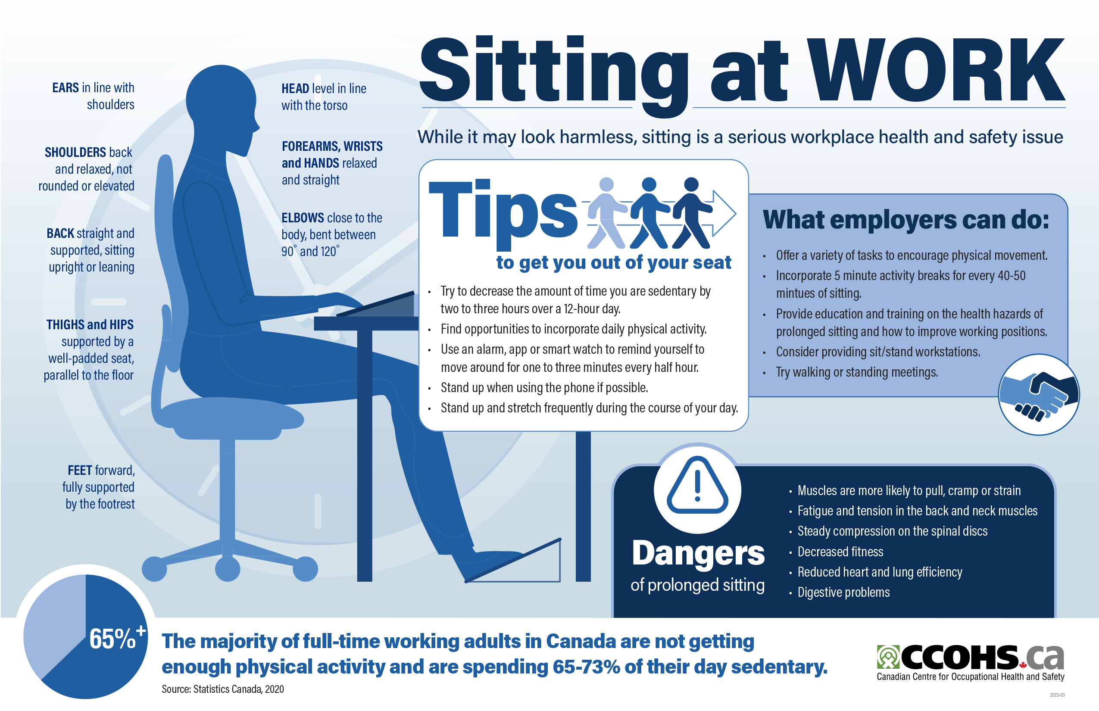

Slide 9
Employer Responsibilities
Under Canada Labour Code
Employer’s Duty:
  Identify and assess ergonomic risks
  Provide ergonomic equipment and training
  Implement ergonomic standards in the workplace
  Ensure workers are educated on proper ergonomic practices

Slide 10
Employer Duties
Ensure the Health and Safety of All Parties in the Workplace
Provide safety equipment and make sure all are familiar with it’s use
Take steps to protect and prevent harassment and violence in the workplace
Ensure non-employees don’t endanger employees
Provide first aid, sanitary, and personal facility services
Identify hazards and implement a prevention program
Ensure employees are not exposed to levels of hazardous substances exceeding the prescribed limits
Ensure fire safety procedures are in place
Address ergonomic issues

Slide 11
Employee Responsibilities
Under Canada Labour Code
Worker’s Duty:
  Report ergonomic hazards
  Participate in training and education
  Use provided ergonomic tools and follow proper workstation setup
  Monitor their own posture and habits

Slide 12
Workplace Ergonomic Assessments
Purpose of Ergonomic Assessments:
  Identify ergonomic risks in the workplace
  Provide personalized recommendations for improvement
  Ensure compliance with safety regulations
How to Conduct an Assessment:
  Evaluate workstation setup
  Observe working habits
  Provide feedback on posture and adjustments

Slide 13
Canada Occupational
Health and Safety Regulations
PART XIX – HAZARD PREVENTION PROGRAM
19.1 (1) The employer shall, in consultation with and with the participation of the policy committee, (…), develop, implement and monitor a program for the prevention of hazards in the work place that is appropriate to the size of the work place and the nature of the hazards and that includes the following components:
a hazard identification and assessment methodology;
hazard identification and assessment;
preventive measures;
employee training; and
a program evaluation.

Slide 14

Summary of Committee Roles
Regional Committees (optional)
  Works in collaboration with their Workplace Committees to ensure national policies and programs are implemented in the region. Keeps the Policy Committee informed of regional health and safety issues.
  Policy Committee
  In collaboration with the employer, establishes national OHS policies and programs, particular to the department.
Workplace Committees
  Plays a more “hands on” role in health and safety issues in the work place by being directly involved in workplace inspections, investigations, etc.

Slide 15
Telework: Committees and Communicating
There will be new processes and new ways of collectively ensuring things get done
While the role of committees is evolving, the actual responsibilities are not changing
Communicating with H&S committees and members who are not consistently in the workplace will be different
Consider formalized ways to work in teams or shifts to reflect work schedules. Consider similar solutions for similar problems e.g. multiple shifts for fire wardens, apply the same approach to first aid or participating in incident investigations

Slide 16
Responsibilities Under Canada Labour Code
Worker’s Duty:
  Report ergonomic hazards
  Participate in training and education
  Use provided ergonomic tools and follow proper workstation setup
  Monitor their own posture and habits
Employer’s Duty:
  Identify and assess ergonomic risks
  Provide ergonomic equipment and training
  Implement ergonomic standards in the workplace
  Ensure workers are educated on proper ergonomic practices

Slide 17
H&S Law in Canada – The Truth
  The most important tool for exercising worker rights is the Policy and Workplace Health and Safety Committees
  Union involvement on these committees will have a direct impact on the health and safety of all workers

Slide 18
127.1 – Internal Complaint Resolution Process
Internal Complaint Resolution Process
Complaint to supervisor
127.1 (1) An employee who believes on reasonable grounds that there has been a contravention of this Part or that there is likely to be an accident, injury or illness arising out of, linked with or occurring in the course of employment shall, before exercising any other recourse available under this Part, except the rights conferred by sections 128, 129 and 132, make a complaint to the employee’s supervisor.

Slide 19
Workplace Committees and Representatives
Deal with local OHS complaints
Make recommendations to management
Inspect the workplace monthly
Maintain adequate records
Participate in inquiries and investigations
Participate in the implementation and monitoring of OHS policies and programs

Slide 20
Tips, Tools and Information
Effective meetings
  Schedule, but be flexible
  Begin and end on time
  Agenda is known well in advance
  Attend! And come prepared
  Participate! Differing opinions are welcome
  Strive for consensus
  Invite speakers – have regular training events
Good recommendations
  Support the Internal Responsibility System
  Support compliance with policy and legislative requirements
  Reduce or eliminate risks

Slide 21
Committee Objectives
  CREATE and MAINTAIN active interest in health and safety, and incident prevention
  RECOMMEND effective action about incident causing conditions
  PROMOTE awareness about health and safety issues
  PROMOTE cooperation between management and employees in dealing with health and safety issues
  HELP identify problems, evaluate risks, and recommend control measures
  ASSIST employer in implementation of control measures and evaluation of their effectiveness
  COOPERATE with the emloyer in formulating policy and procedures
  MONITOR and IMPROVE workplace health and safety

Slide 22
Thank you!

