Slide 1


Online Chat (Amazon)
Overview of Core Components
Presenter: Jad Slim

Slide 2
The Online Chat Project
Online Chat project leverages AWS and most importantly Amazon Connect as it’s omni channel contact center.
Amazon Connect provides us with important set of tools such as:
  Topic based routing
  Real time metrics
  Easy to use management tool
The Online Chat Project is composed of two main modules:
  The Chat Widget
  The Contact Control Panel

Slide 3
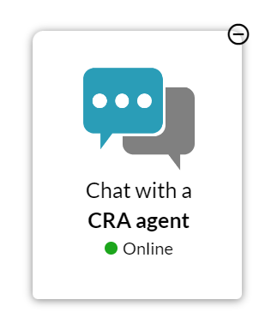

Online Chat Widget
The Online Chat widget is located on the Canada.ca page.
Interacting with the widget allows Tax payers to get access to client support from a live agent.
Maximized
Minimize Widget
Maximize Widget
Service Status
Minimized

Slide 4
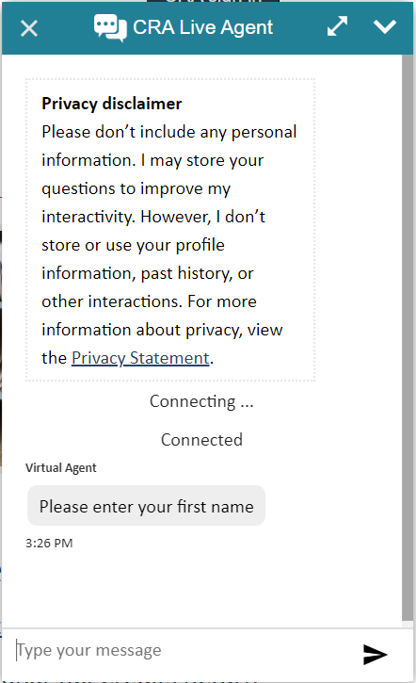
Online Chat Widget
Close
Minimize
Expand
Text Input

Slide 5
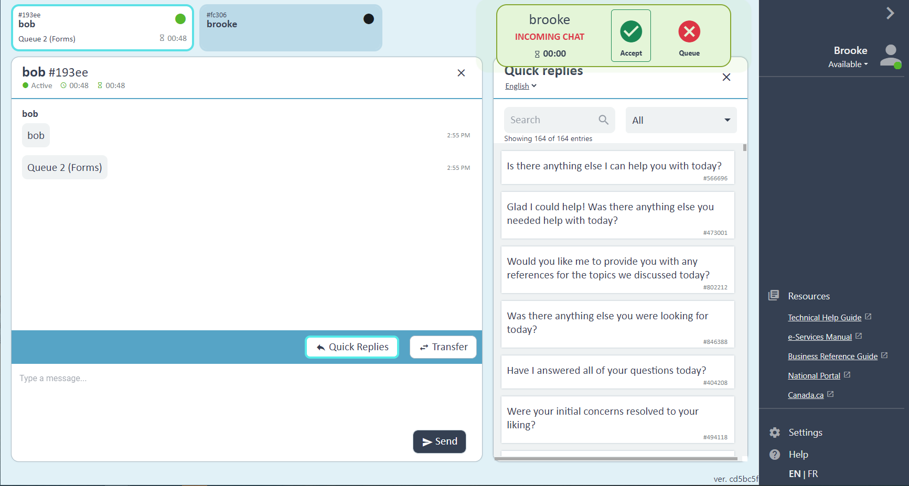
Contact Control Panel (CCP)
The CCP is used by agents to interact with clients through chat.
License Plates
Notification Panel
Side Navigation
Communication Panel
Quick Replies/Transfer

Slide 6
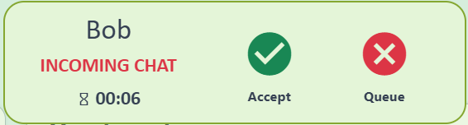
Notification Panel ~ CCP
Client Name
Accept/Reject
Disconnect Time

Slide 7

License Plates ~ (CCP)
Client Name And Id
Client Status
Topic Selected
Time Since Last Message
Available
Idle
Not Responsive
Disconnected

Slide 8
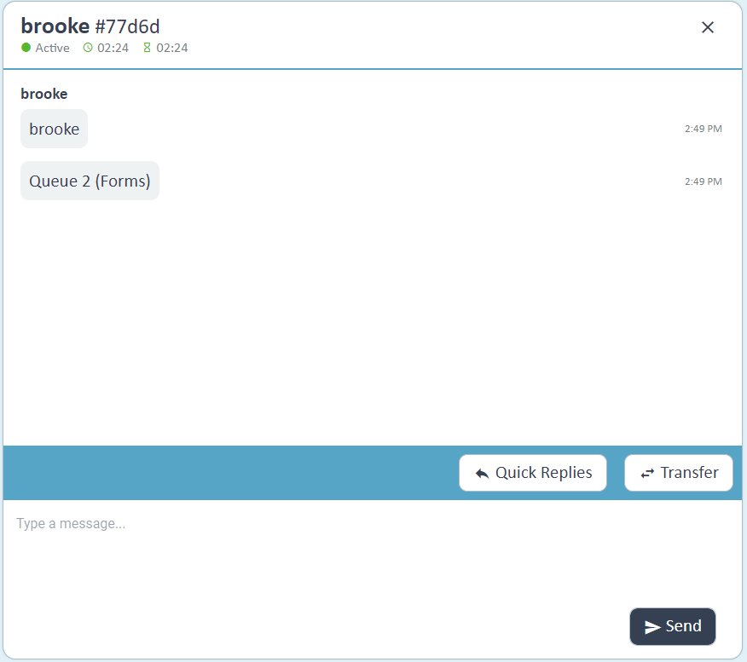
Communication Panel (CCP)
Client Name/Status/Time
Chat History
Quick Replies/Transfer buttons
Text Input

Slide 9
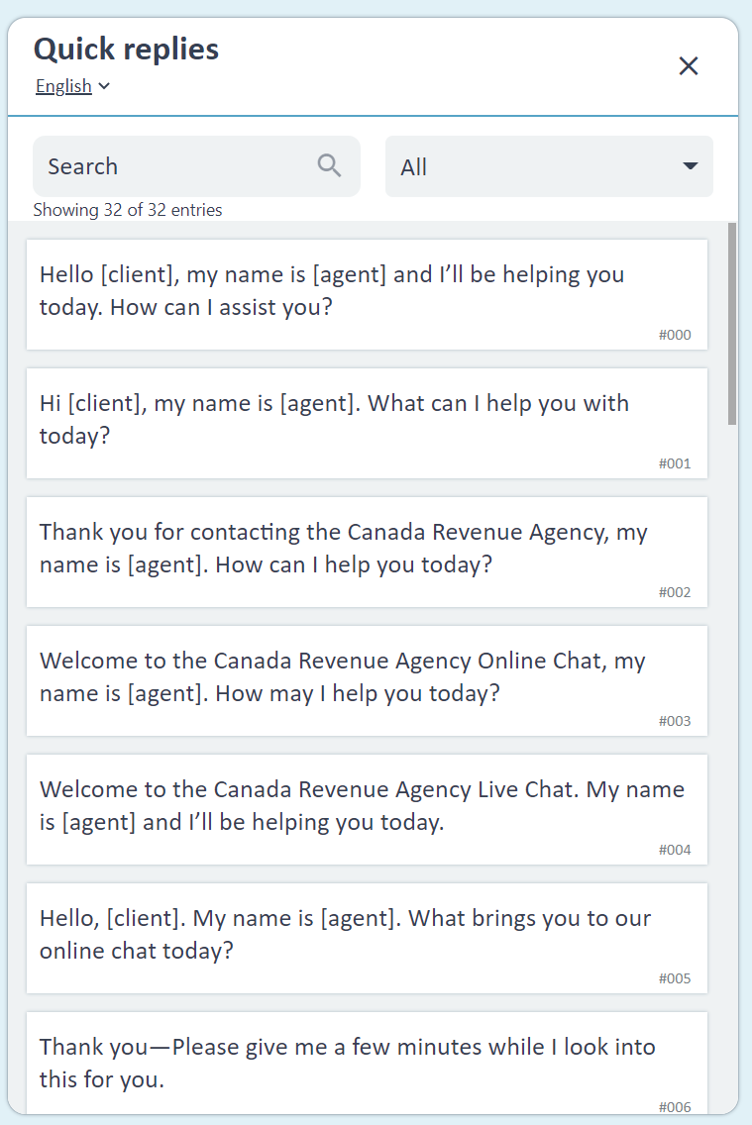
Quick Replies ~ CCP
Language Toggle
Search
Categories
Quick Reply Elements

Slide 10
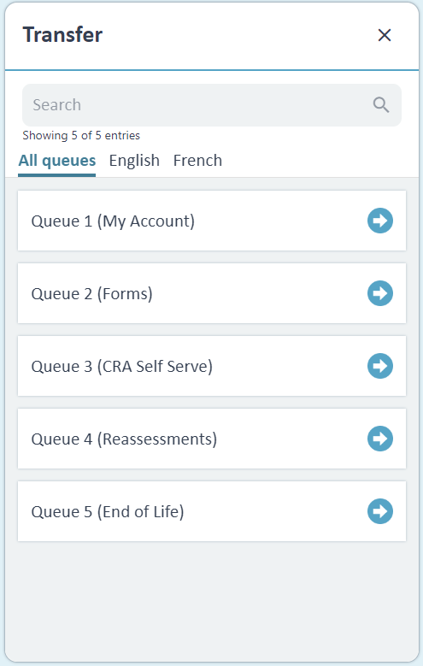
Transfer~ CCP
Search
Categories
Transfer Queues

Slide 11
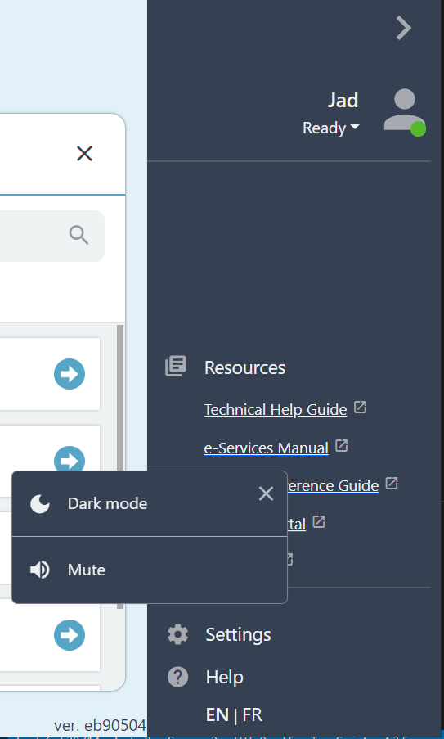
Side Navigation ~ CCP
Name
Status
Dark Mode/Mute Setting
Helpful Resources
English/French Toggle

Slide 12
Side Navigation ~ CCP
Some comparisons between AWS Online Chat and Microsoft Dynamic
 | AWS Online Chat | Microsoft Dynamic
The ability to consult with internal employee, while on a chat | Not available | Available out of box
The ability to have a 3 way chat – most importantly when an agent needs a TL to step in. | Not Available | Available out of box
Accessible UI (font size, contrast, screen reader, keyboard navigation | Fully customizable | Vendor dependent
Agent skill based routing | Full configuration out-of-box | Flexible configuration out-of-box
Queue management | Fully configurable out-of-box | Flexible configuration out-of-box
Data access | Full access to all chat data | Considerable work required to download chat data
Chat transcript search / tagging | Out-of-box | Not available
Integrate with voice channel | Out-of-box
Consumption model | Pay-per-use | User license
PBMM maturity | In progress | Not available

Slide 13
DEMO

Slide 14
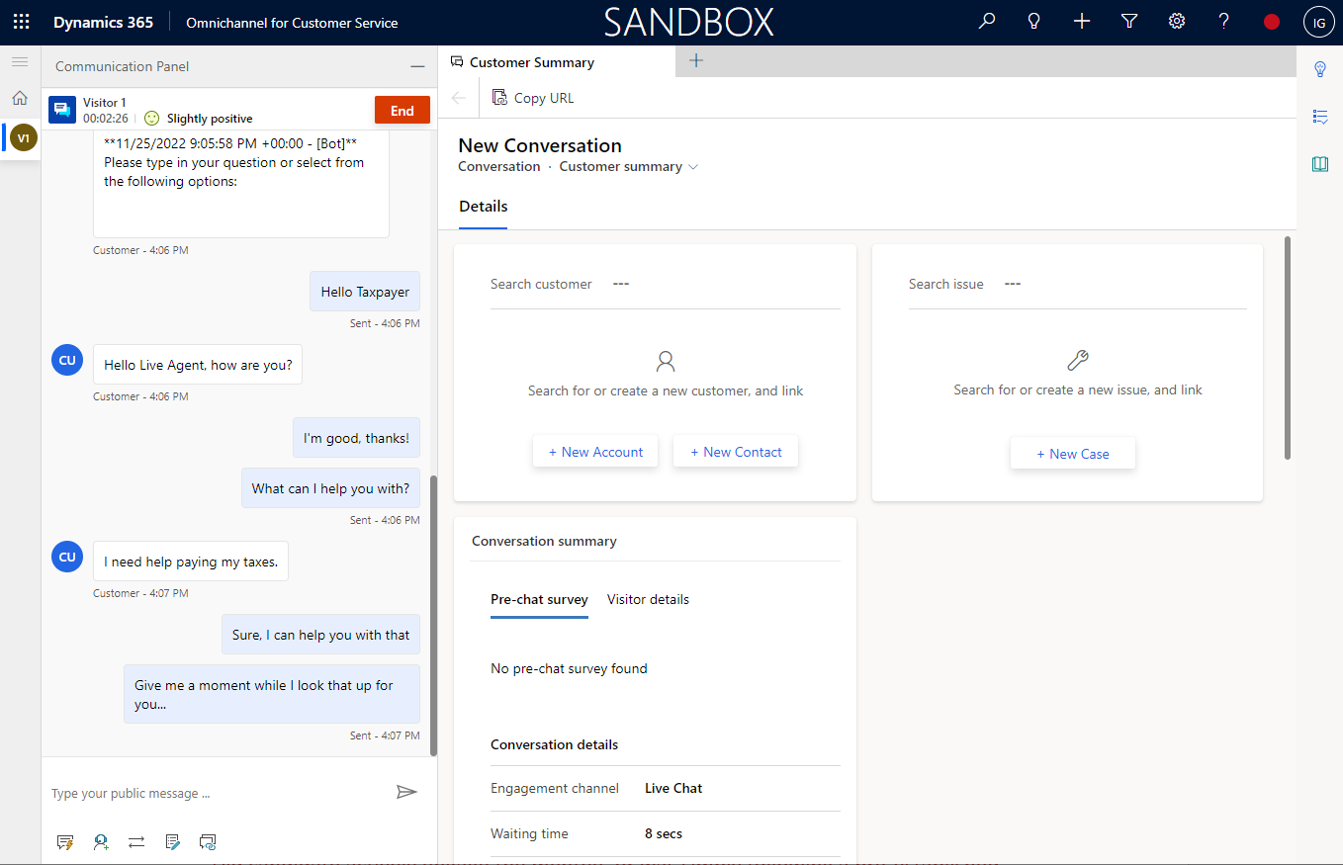
Dynamics 365

Slide 15
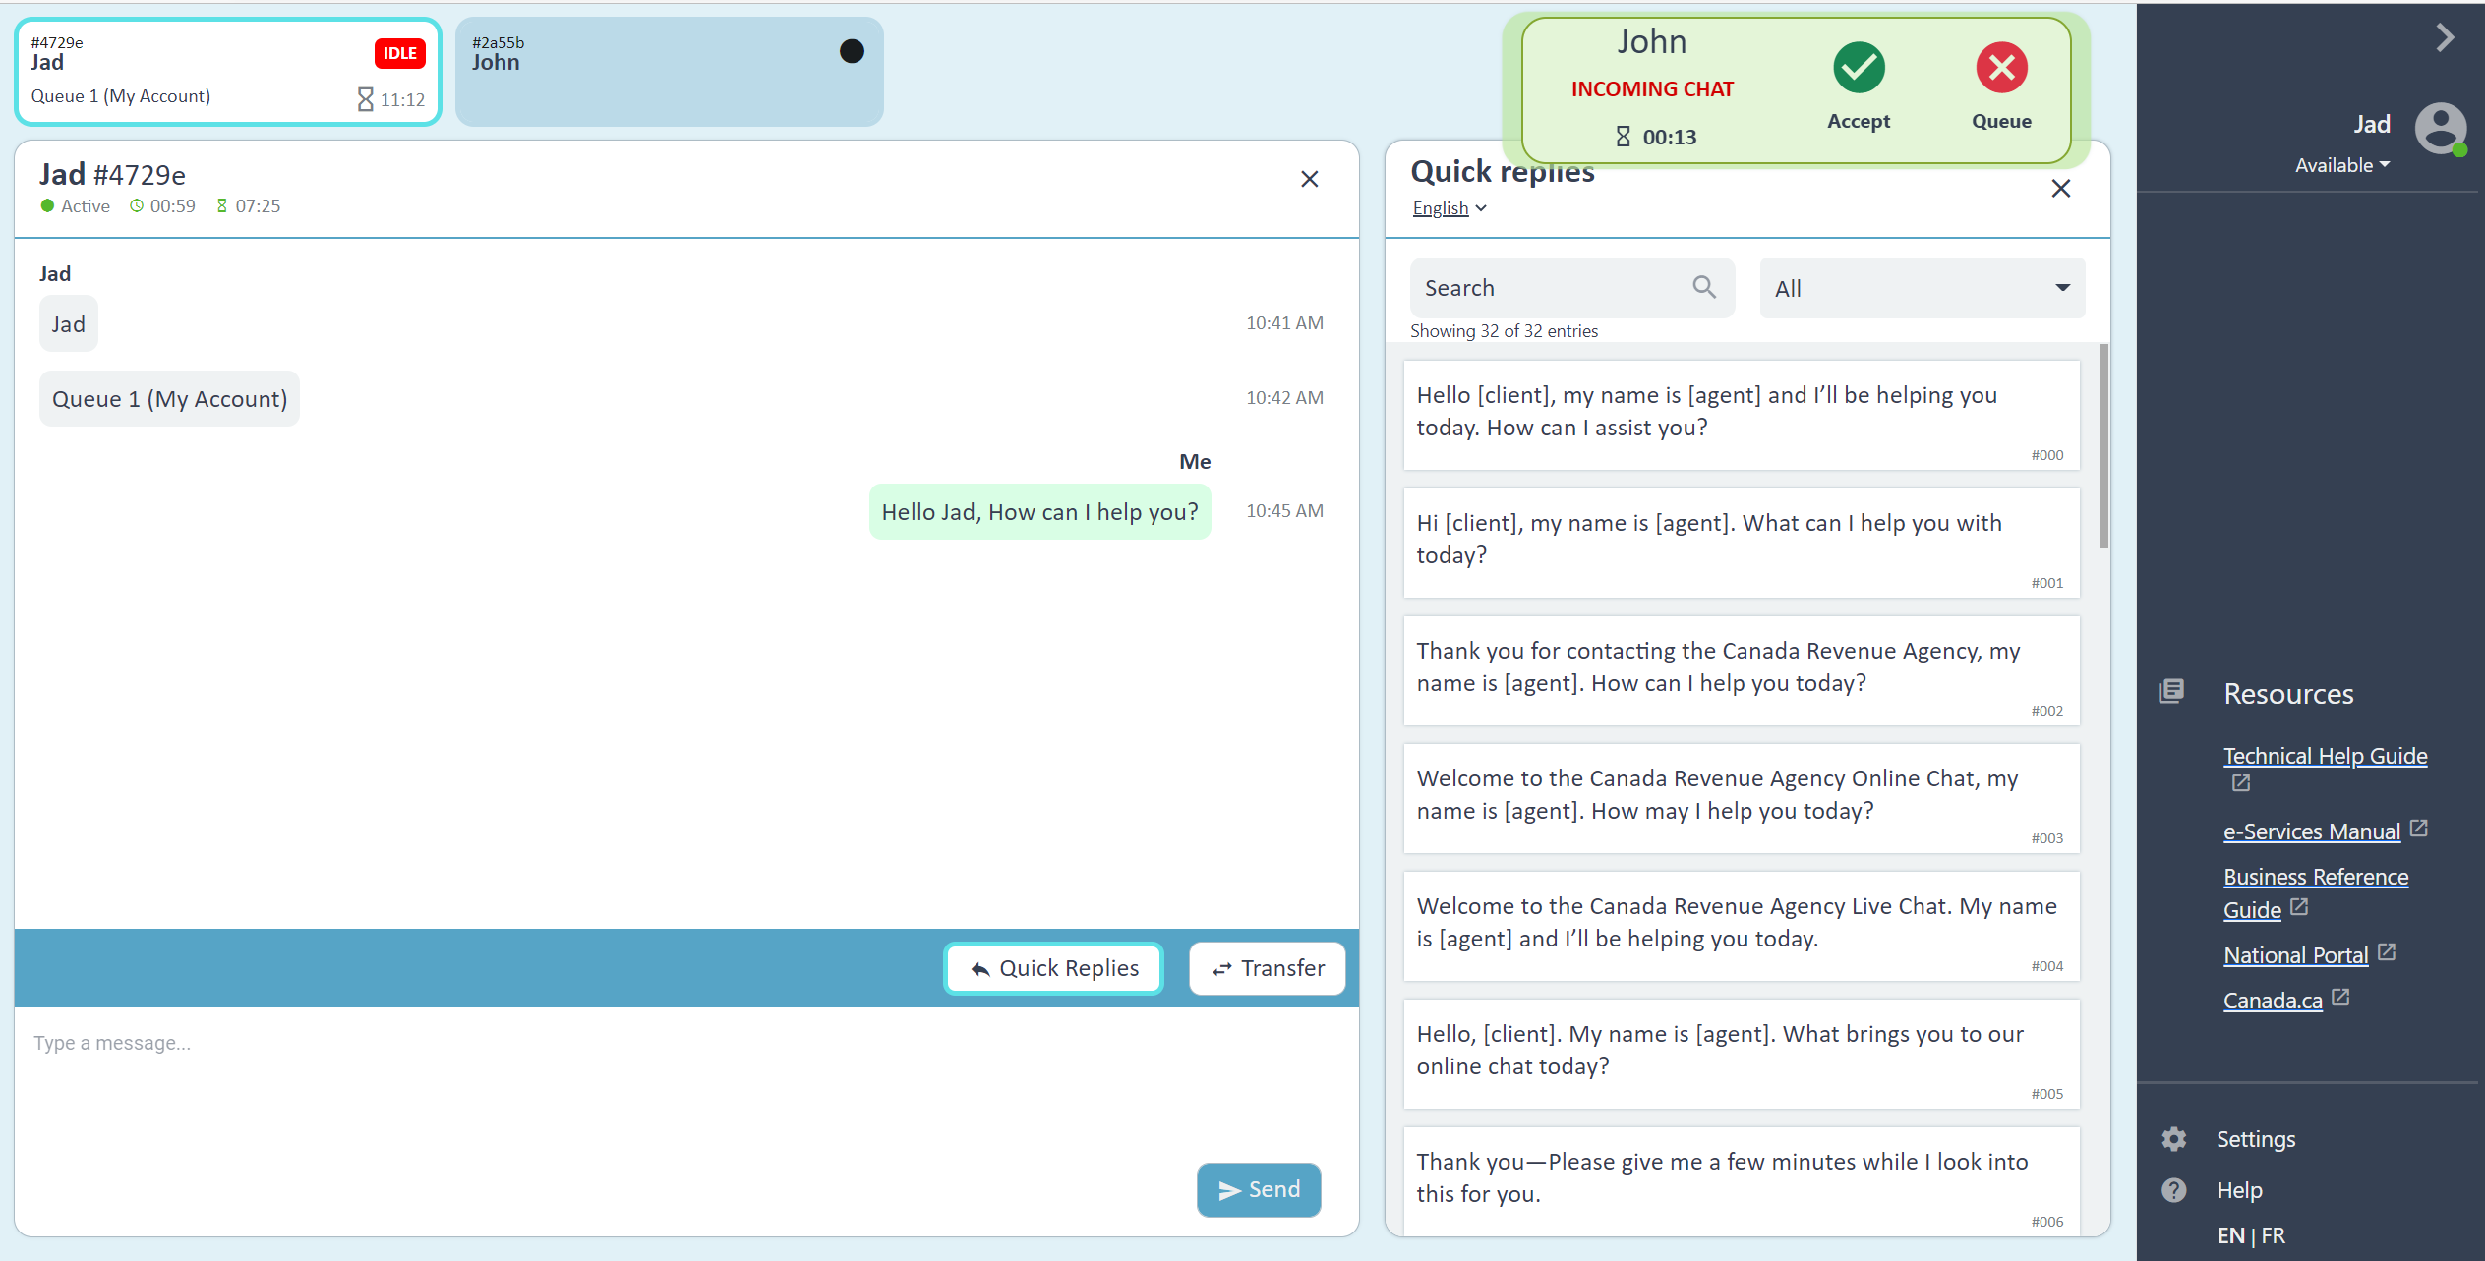
Amazon Connect

