Slide 1
CRA Occupational Health and Safety
October 19, 2012

Slide 2
Agenda
OHS Structure & Network Within the CRA
OHS Program Focus
Work Place Health and Safety Committees
CRA Based Resources

Slide 3
OHS Structure
Following OHSAS 18001:2007 Standard
OHS Policy
Identify Hazards
Accident trends
OHS Program
Plan
Do
Check
Act
Reporting
Establish Improvement Objectives
Develop & Implement Prevention Programs
Establish Roles and Responsibilities
OHS Communication
Monitor
Work Place OHS Committees

Slide 4
Proposed CRA OHS Management Structure
CRA
OSH Policy
H&SMS
Supporting
Policies
Directives
Procedures,
Guidelines,
Standards, Tools
National
OHS Group
(Structure, Policies
& National
Prevention Programs)
Regional
OHS Advisors
(National Policy and
Program Implementation
& Local Prevention Programs)
OSH Committees &
Working Groups
(National &
Work Place)

Slide 5
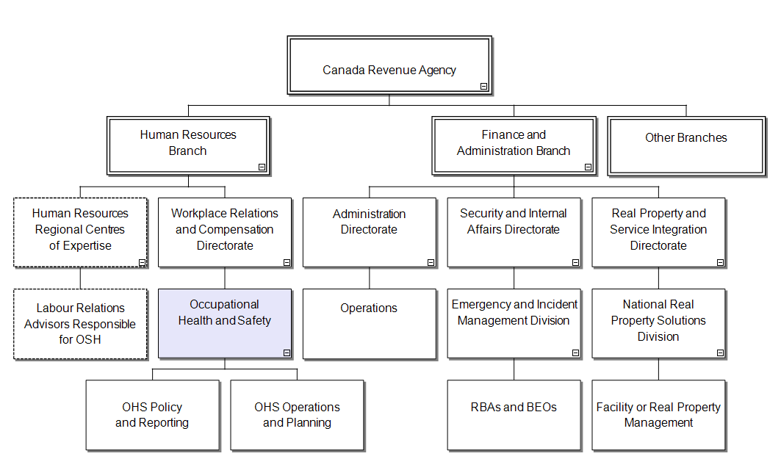
OHS in the CRA

Slide 6
OHS Network Within the CRA
National office within HRB and WRCD:
Policy development;
National monitoring and reporting;
Manage NHSPC; and
Center of expertise in OHS.
National Health and Safety Policy Committee:
Consultation forum for employer and employee representatives to meet, exchange information, discuss and consider national OHS issues within the CRA.
Regional representatives:
Implementation and maintenance of OHS policies and prevention initiatives;
Regional monitoring and reporting;
Support WPHSCs; and
Regional OHS expertise.
Work Place Health and Safety Committees:
Consultation forum for employer and employee representatives to meet, exchange information, discuss and consider local OHS issues.

Slide 7

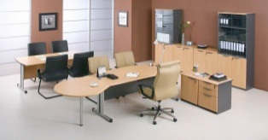


OHS Program Focus: Job Hazard Analysis Results
Following the completion of the JHA for Field Employees and MEJHA, the main hazard categories identified included:
Ergonomics
Office Ergonomics
Manual Material Handling
Work Place Environment
Indoor Air Quality / Temperature
Machine and Electrical Safety, Personal Protective Equipment
Slips, Trips and Falls
Ice and Snow Clearance
Additional Elements
Work Place Violence
OHS Awareness

Slide 8
OHS Program Focus: Accident Trends
On average = 719 accidents per year

Slide 9
OHS Program Focus - Accident Trends

Slide 10

Work Place Health and Safety Committees:
What role can a Work Place Health & Safety Committee and Representative play?
Have proactive discussions on the control of hazards in the workplace
Workplace inspections and participate in OHS investigations
Provide employees with information on OHS topics (NAOSH week, etc.)
Provide recommendations to management
Discuss local employee health and safety concerns
Participate in OHS Program monitoring

Slide 11

Work Place Health and Safety Committees:
What resources are available to WPHSCs and Representatives?
National CRA OHS Web-site
with area dedicated to WPHSCs and Representatives
Quarterly WPHSC and Representative Newsletter
Health and Safety, Everybody’s Business
Regional and/or local Web-sites
Local expertise
Representatives from: Labour Relations, Real Property, BEO, etc.
External Web-sites
CCOHS, HRSDC, etc.
Relevant Documents
WPHSC training materials, Legislation, Standards,
Prior WPHSC and/or NHSPC minutes, etc.

Slide 12
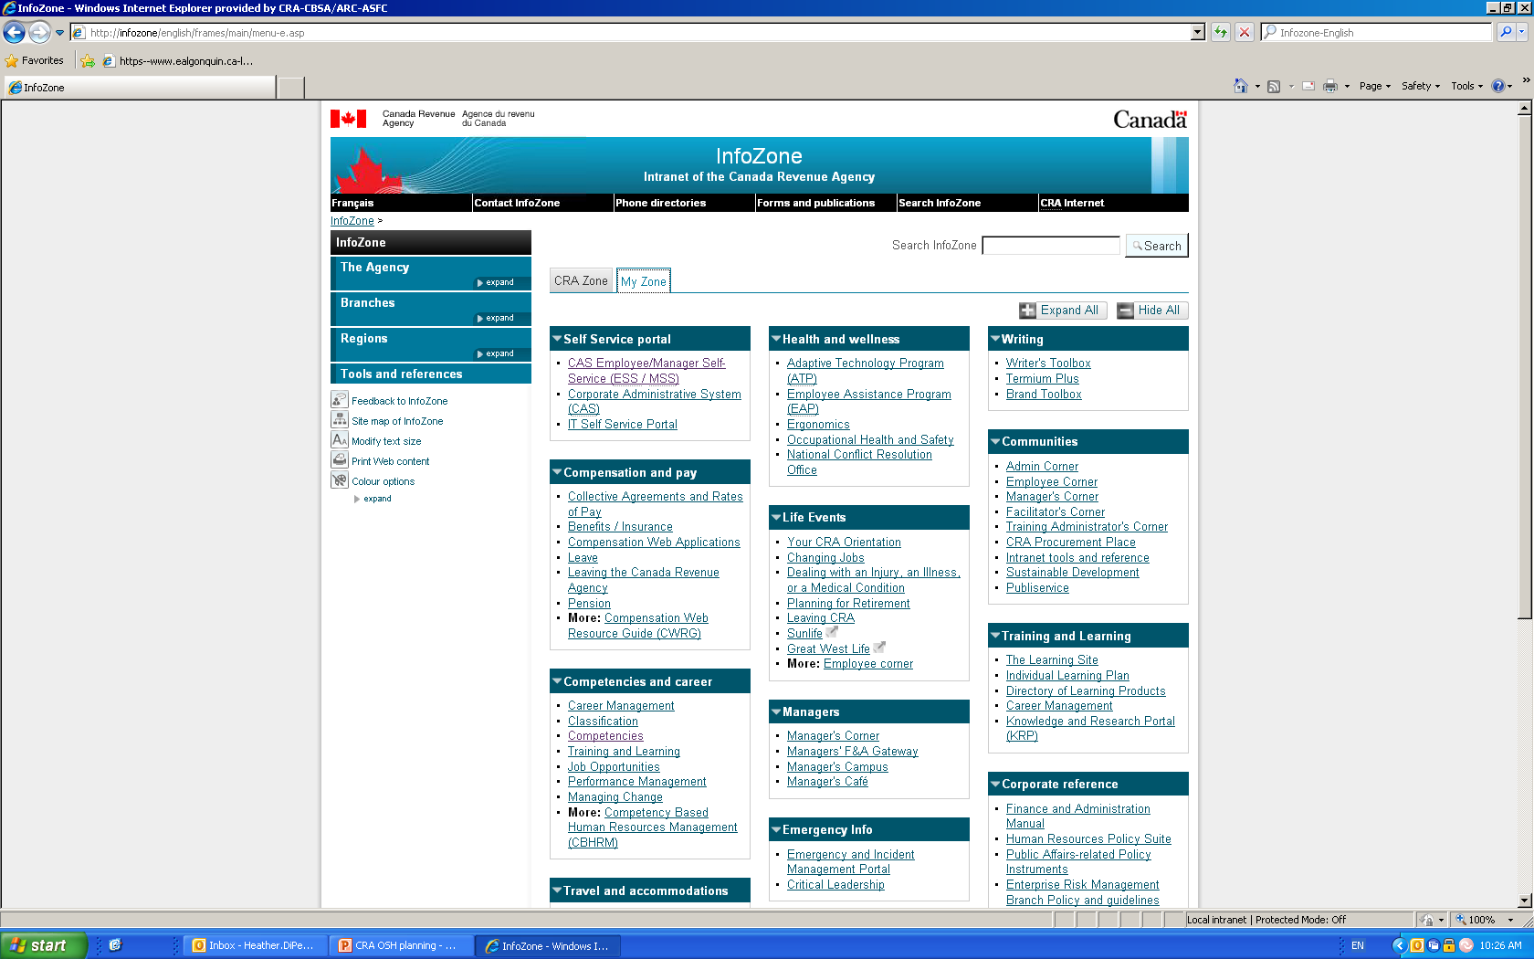
CRA Web-based Resources
Go to “My Zone” and select “Occupational Health and Safety”

Slide 13
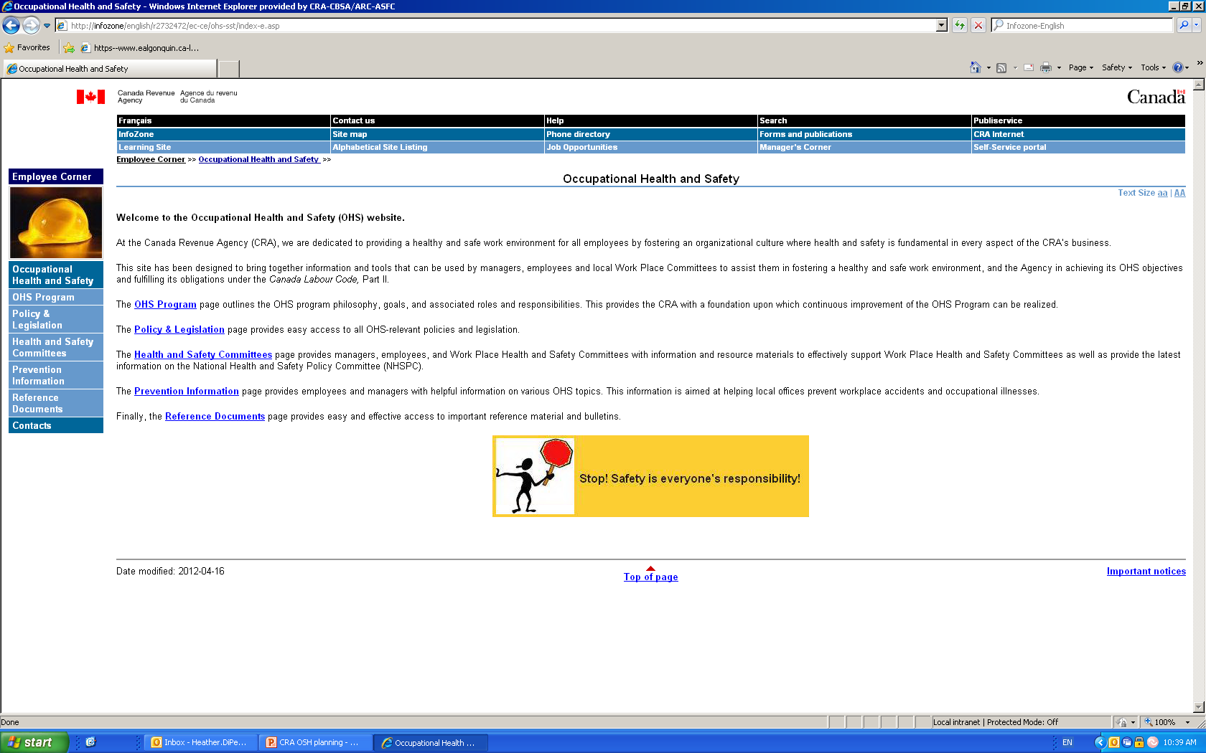
CRA Web-based Resources
From the main page select “Health and Safety Committees”

Slide 14
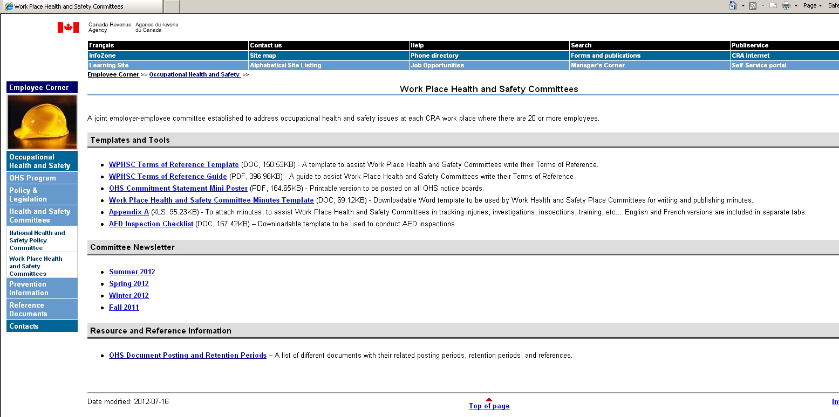
CRA Web-based Resources
“Health and Safety Committees” will provide information on and for the NHSPC as well as the WPHSCs

Slide 15
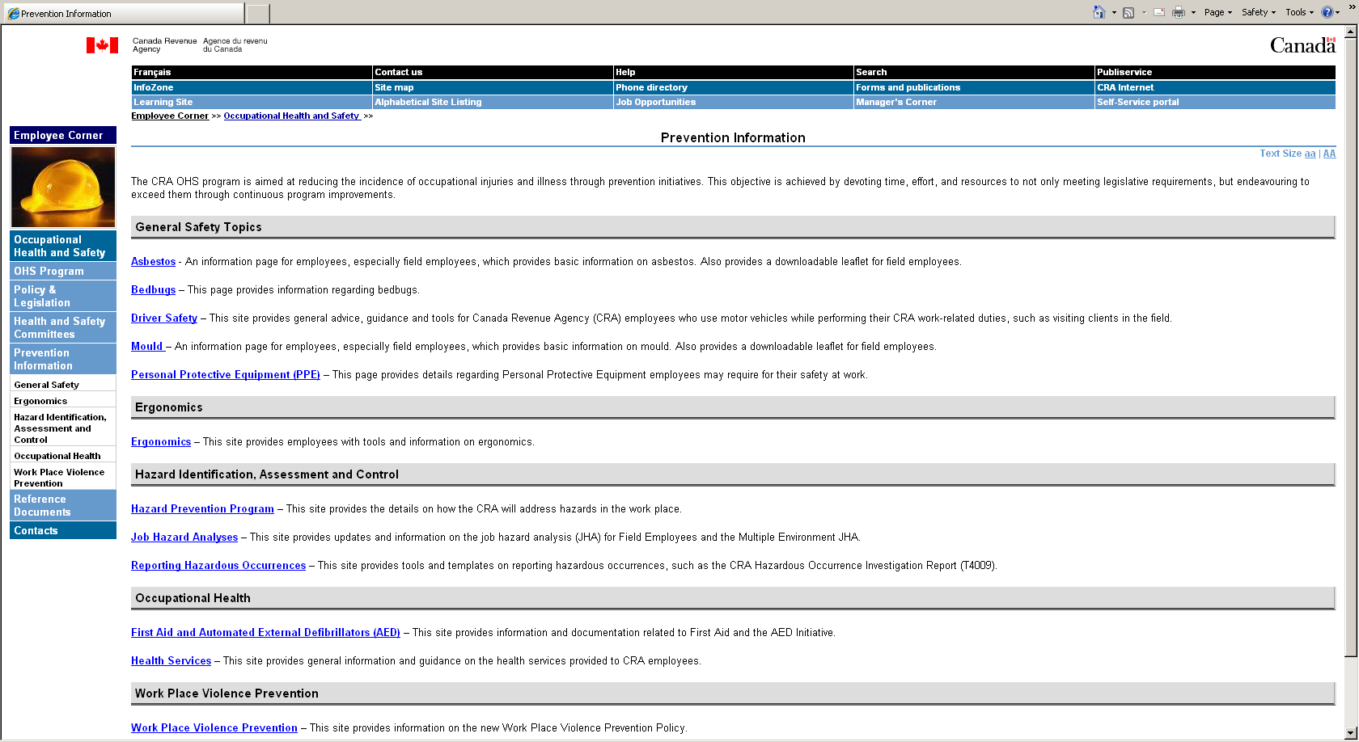
CRA Web-based Resources
Within “Prevention Information”, there is other information available for WPHSCs

Slide 16
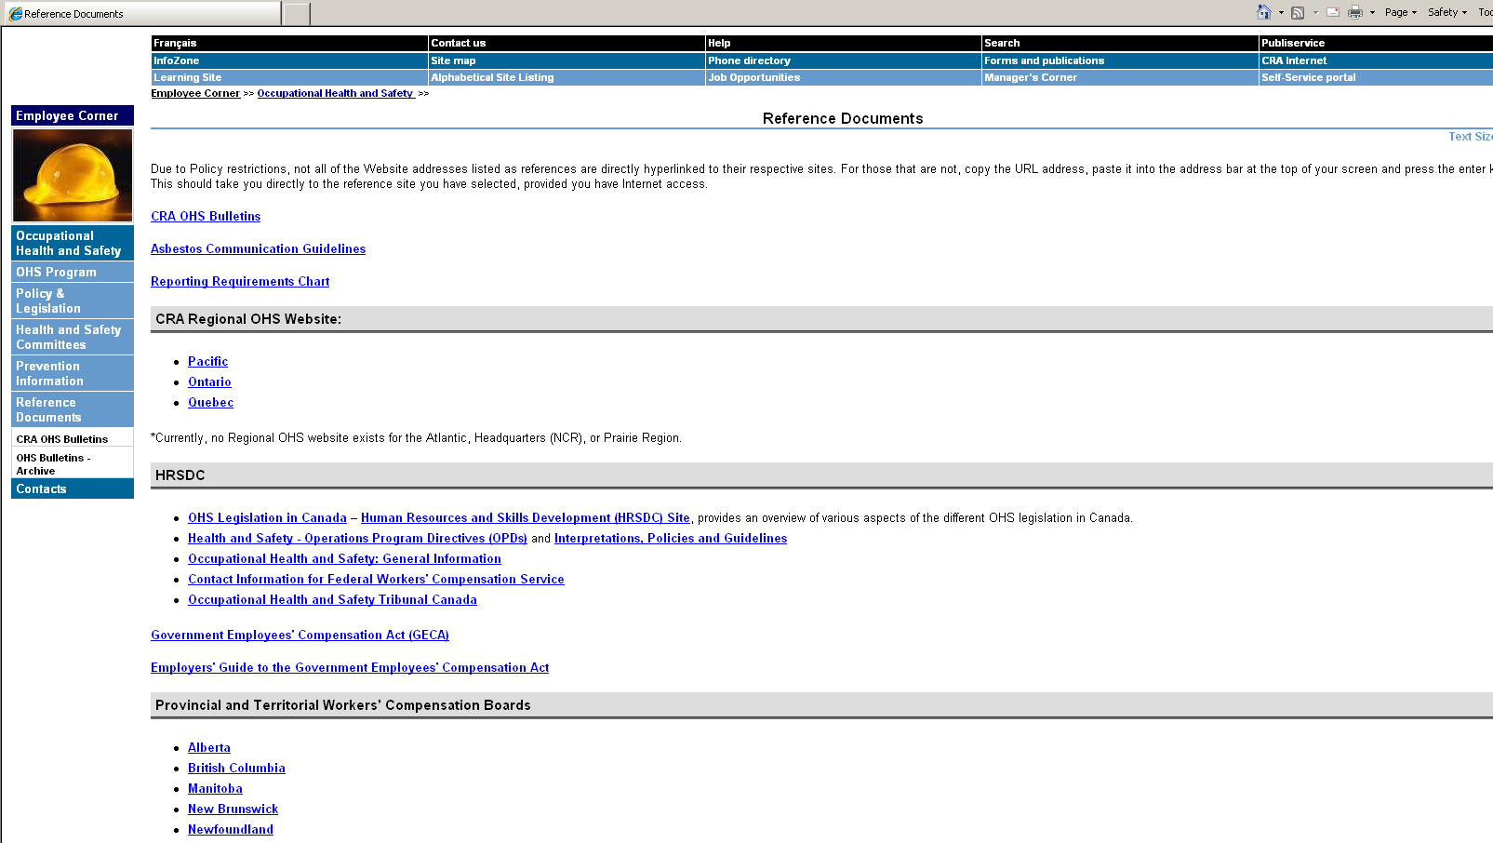
CRA Web-based Resources
Within “Reference Documents” there are links to reference materials and other Web-sites (both internal and external)

Slide 17

Questions

