Slide 1
Bill C-4: Changes to the Canada Labour Code Part II
Changing the health and safety landscape to fit the conservative ideology
Denis St-Jean
National Health and Safety Officer
UTE National Health and Safety Conference
November 2015

Slide 2
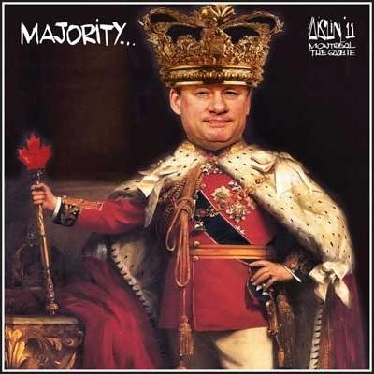
Economic Conservatism: More freedom through less government
According to Stephen Harper:
"The welfare state has placed unprecedented power in the centralizing hands of the federal bureaucracy, both in term of its new reaches into Canadian life and its insistence on standardizing all policies and practices on a national scale".
Source: Canadian Centre for Policy Alternatives, The Harper Record, www.policyalternatives.ca/Reports/2008/09/HarperRecord/index.cfm

Slide 3

Maintain an exhaustive system of information control
All previous amendments to the Code were achieved through extensive consultations with Unions, employers and government representatives.
Bill C-4 was brought forward with no consultation with any stakeholders

Slide 4
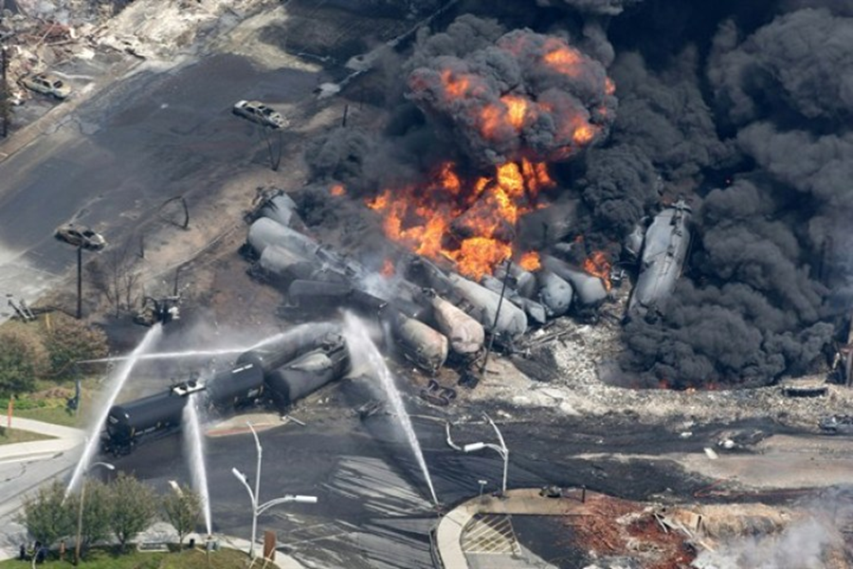
What happens when you ask Transport Canada about rail safety reforms?
Smoke rises from railway cars that were carrying crude oil after derailing in downtown Lac-Mégantic, Que., July 6, 2013.

Slide 5
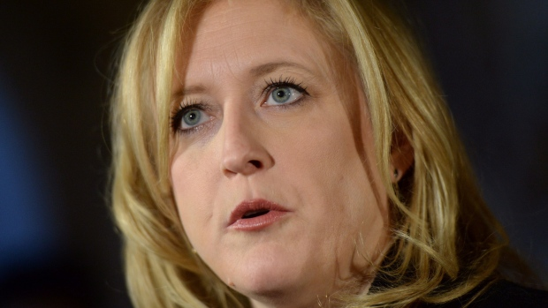

What happens when you ask Transport Canada about rail safety reforms?
February 2014:
Transport Canada refuses to discuss why it grants exemptions to freight rail companies on issues such as brake inspections and safety rules, claiming it is private information.
Reports in the news recently revealed that Canada’s rail regulator has waived a number of safety rules and orders for both CN Rail and CP Rail operations in recent years. Transport Canada refused to offer reasons.
Minister Lisa Raitt:
"We cannot provide details on specific exemption requests, as these are third-party information and subject to privacy regulations".

Slide 6
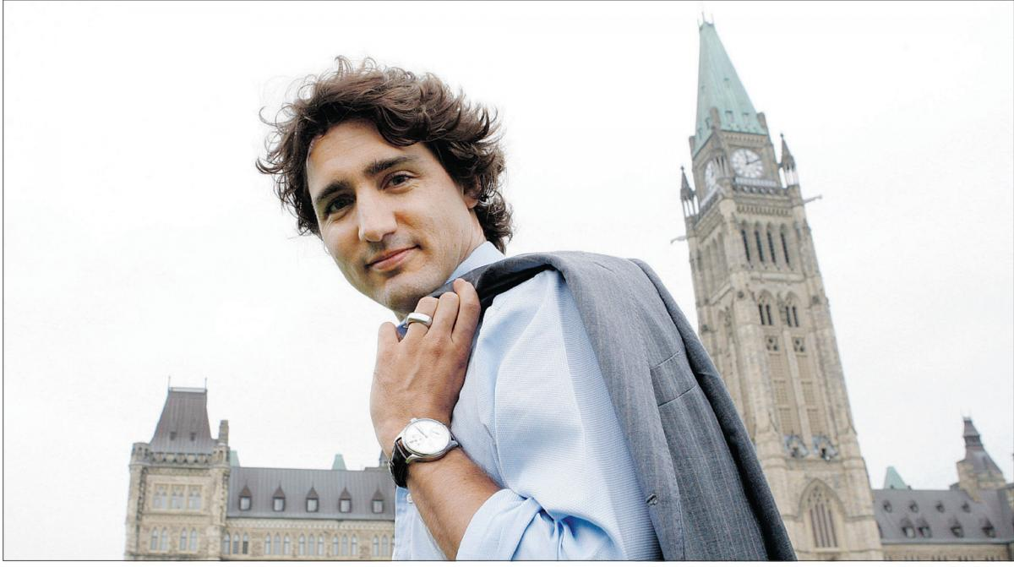
What happens when you ask Transport Canada about rail safety reforms?
Justin Trudeau in Parliament on The Auditor General’s 2013 Fall Report:
"The Conservative government has continued to fail Canadians when it comes to ensuring basic safety measures, specifically regarding rail and food safety“.
"Basic information on such important data as the sections of tracks used for transporting dangerous goods and the condition of railway bridges is missing. Canadians deserve a government that will act to protect their safety".

Slide 7

What happens when you ask Transport Canada about airline safety reforms?
Transport Canada inspectors are being increasingly pulled away from their regulatory oversight role and there are less of them, and that’s a worrying development for Canadians’ aviation safety, says the union representing the inspectors who work for the Transport Ministry.
The International Civil Aviation Organization (ICAO) is concerned by the impact of the aviation Safety Management Systems (SMS) which increasingly passes oversight to the aviation industry and depends more on self-regulation.

Slide 8
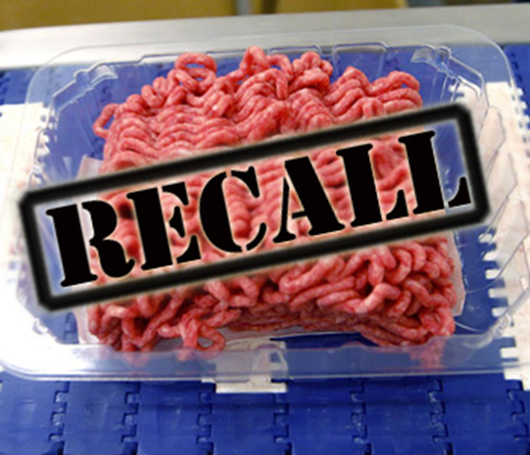
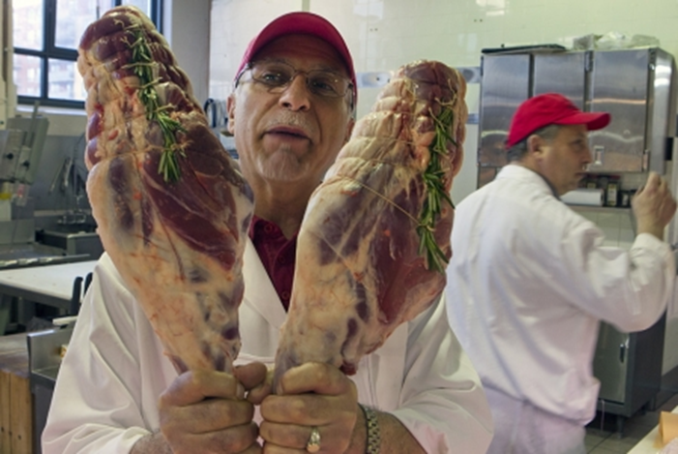
What About Food Safety Reforms?
Epidemic of stress sweeps ‘dysfunctional’ Canadian Food Inspection Agency (CFIA): employees seek counselling at rate three times the federal average.
Agriculture Union pointed out that this dramatic rise in the need for counselling has emerged in lockstep with cuts to staffing and other CFIA resources.
The Agency is simply setting up their employees for failure, with the human toll that inevitably takes.

Slide 9
What About Food Safety Reforms?
U.S. food-safety audit gives Canada low grade, calls for better meat oversight (Jan 7, 2014).
Canada’s food-safety system faced heightened scrutiny after 23 people died in an outbreak of listeriosis linked to a Maple Leaf Foods plant in Toronto in 2008, and E. coli contamination in 2012 at the former XL Foods facility near Brooks, Alta., led to the largest meat recall in Canadian history.

Slide 10
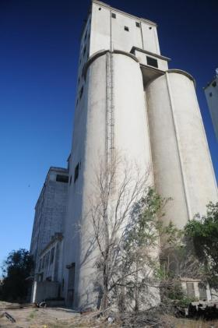
What About Grain Safety Reforms?
The Conservative federal budget Bill C-45 contains amendments to the Canada Grain Act that will increase self-regulation and decrease overall inspections.
Inspectors collect grain samples from every rail car that comes to the elevators and inspect for quality, pests and diseases, as well as toxins, foreign materials or anything that could be damaging to the grain or harmful for human consumption.

Slide 11



What About Public Interest Science?
Federal Scientists Feel They Can’t Speak Out, Even If Public Health and Safety at Risk
A major survey of federal government scientists commissioned by the Professional Institute of the Public Service of Canada (PIPSC) has found that 90% feel they are not allowed to speak freely to the media about the work they do and that, faced with a departmental decision that could harm public health, safety or the environment, nearly as many (86%) would face censure or retaliation for doing so.

Slide 12


Silence of the Labs: the ideological shutting down of Canadian science
In the past five years the federal government has dismissed more than 2,000 scientists, and hundreds of programs and world-renowned research facilities have lost their funding. Programs that monitored things such as smoke stack emissions, food inspections, oil spills, water quality and climate change have been drastically cut or shut down.
http://www.cbc.ca/fifth/episodes/2013-2014/the-silence-of-the-labs

Slide 13
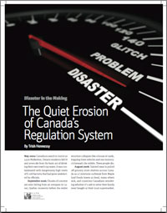
Analysis by the Canadian Centre for Policy Alternatives
What we don’t know can hurt us.
Over the past generation, there has been a slow, steady and silent erosion of regulations by governments intent on “reducing paper burden”, making Canada “more competitive” and governments more “cost-effective”.

Slide 14
Analysis by the Canadian Centre for Policy Alternatives
Self-regulation: it is like putting a wolf in charge of a henhouse
Nine Canadians in ten want their governments to do more to protect our environment: 84% claim that companies put profits ahead of safety.

Slide 15
C-4- Investigations and Inspections
Sections 176 and 190 of Bill C-4
Repealed the definitions “health and safety officer” and “regional health and safety officer” and replaced with "the Minister" throughout the legislation
The Minister can delegate all her powers to anyone she deems to be qualified.
The neutral, trained, specialized inspectorate of health and safety enforcement personnel currently in place could be ousted by these provisions and replaced with ad hoc private entrepreneurs, dependent on the government for their next contract.

Slide 16
C-4- Investigations and Inspections
Opens the door to the politicization of the important role of monitoring and enforcement
There is strong evidence that only actual citations and penalties reduce the frequency or severity of injuries in the workplace
Over the last several years, the ratio of employees to federal inspectors has increased dramatically
One cannot avoid noticing that the largest employer to be subject to inspections is the government itself
We take the position that this provision puts the Minister of Labour in a conflict of interest where she will be subject to accusations of biased decision making in favour of Cabinet colleagues and against workers.

Slide 17
C-4- Investigations and Inspections
Bill C-4 states that the Minister of Labour may administer or enforce electronically the Canada Labour Code
A virtual investigation guide for the inspectors is already being prepared
There is no data on the efficiency of any existing virtual investigation services in occupational health and safety

Slide 18
The New Definition of "Danger"
Workers in Canada have a right to refuse dangerous work as their last line of personal protection when faced with the choice between doing an activity that will injure or kill them and being disciplined or even losing their job.
Bill C-4 proposes to dramatically roll back the definition of what constitutes a “danger” currently found under subsection 122(1) of the Canada Labour Code Part II.
Subsection 176(2) of Bill C-4 eliminates the current definition of “danger”.

Slide 19
The New Definition of "Danger"
Previous definition:
“danger” means any existing or potential hazard or condition or any current or future activity that could reasonably be expected to cause injury or illness to a person exposed to it before the hazard or condition can be corrected, or the activity altered, whether or not the injury or illness occurs immediately after the exposure to the hazard, condition or activity, and includes any exposure to a hazardous substance that is likely to result in a chronic illness, in disease or in damage to the reproductive system

Slide 20
The New Definition of "Danger"
Changed to:
“danger” means any hazard, condition or activity that could reasonably be expected to be an imminent or serious threat to the life or health of a person exposed to it before the hazard or condition can be corrected or the activity altered

Slide 21
The New Definition of "Danger"
This change means we have lost the concept of "future activities"
removes the right to refuse based on danger as a potential occurrence (now all based on imminent or serious threat to life or health); which means that workers will have to be in harm’s way before they can establish that their working conditions are dangerous
removes the idea that workers deserve protection from activities or conditions that could cause them danger in the future
the threat to life or health has to be based on something that has to be happening almost immediately or very soon (no more based on the concept of potential hazard)

Slide 22
The New Definition of "Danger"
Removes references to :
(Danger) to includes any exposure to a hazardous substance that is likely to result in a chronic illness, in disease or in damage to the reproductive system;
Removes the specific reference to " illness" in the expression "that could reasonably be expected to cause injury or illness to a person exposed to it“
Workers will likely not be able to claim protection from potential chronic or slow developing illnesses based on exposure to carcinogens or teratogens.

Slide 23
The New Definition of "Danger"
We have potentially lost the right to refuse on exposure to friable asbestos, diesel fumes or any other cancer-causing chemicals with a latency period of any symptoms.
Even though diesel fumes have been recently recognized as a definite cancer-causing substance; we have lost health and safety rights for workers exposed to truck exhaust (i.e. PSAC border services officers)

Slide 24
The New Definition of "Danger"
Removes the concept of exposure to hazardous substances that are likely to result "in damage to the reproductive system"
Have lost any recognition of hazards having an impact of the reproductive system, a major setback for the health and safety of women in the workplace.

Slide 25
The Right to Refuse Dangerous Work Section 128 of the Canada Labour Code, Part II
An Initial investigation by the employer and the employee: written report.
(Canada Labour Code, new section 128(7.1))
Health and safety committee investigation: written report to the employer.
(Canada Labour Code, new section 128(10.1))
Employer can submit new facts to the health and safety committee and ask them to consider amending their report.
(Canada Labour Code, new section 128(10.2))

Slide 26
The Right to Refuse Dangerous Work Section 128 of the Canada Labour Code, Part II
Employer who is in receipt of the report from the health and safety committee can consider three options: "danger", "no danger" or "no right to refuse" based on the fact that these are normal conditions of employment or the refusal puts the life of someone else in danger.
(Canada Labour Code, new section 128(13))
Continued refusal by the worker: reports to be provided to the Minister and interestingly includes both the initial employer report and the health and safety committee report.
(Canada Labour Code, new section 128(16))

Slide 27
The Right to Refuse Dangerous Work Section 129 of the Canada Labour Code, Part II
Investigation of the Refusal by the Minister of Labour
(Canada Labour Code, new section 129)
The Minister to determine if an investigation is warranted. The Minister can refer the continued refusal to another Part of the Canada Labour Code (Part I or Part III) or even another investigation established under another Act of Parliament.
(Canada Labour Code, new section 129(1))
The Bill has not included a right to appeal the Minister’s decision to not investigate the worker refusal to work

Slide 28
The Right to Refuse Dangerous Work Section 129 of the Canada Labour Code, Part II
New test for the continued refusal to be considered: The Minister may decide not to investigate if the matter is "trivial, frivolous or vexatious" or if the continued refusal is considered by the Minister to be "in bad faith".
(Canada Labour Code, new section 129(1)).
The Minister is then required to inform in writing the employee and the employer. The employer must then inform the members of the committee.
(Canada Labour Code, new section 129(1.1))
Once informed of the Minister’s decision not to proceed, the employee cannot continue to refuse to work.
(Canada Labour Code, new section 129(1.2)).

Slide 29
The Right to Refuse Dangerous Work Section 129 of the Canada Labour Code, Part II
If the Minister decides to proceeds, the refusal process can continues.
(Canada Labour Code, new section 129(1.3)).
Investigation may include the employee, the employer and an employee representative of the workplace committee or health and safety representative, or, if warranted, an employee representative chosen by the employee.
(Canada Labour Code, new section 129(1.4) -This sub-section is similar to the previous requirements found in section 129 (1)).

Slide 30
The Right to Refuse Dangerous Work Section 129 of the Canada Labour Code, Part II
The Minister will check for previous investigations in relation to the same employer or involving the same issues.
(Canada Labour Code, new section 129(3.1)).
The Minister will issue a written decision to the employer and the employee considering three options: "danger", "no danger" or "no right to refuse" based on the fact that these are normal conditions of employment or the refusal puts the life of someone else in danger.
(Canada Labour Code, new section 129(4)).

Slide 31

Federal inspectors
And what about those federal inspection services?

Slide 32

Federal inspectors
In workplaces under federal jurisdiction, federal labour inspectors or labour affairs officers (LAO) are responsible for enforcing legislation.
They are members of PSAC (Union of National Employees)

Slide 33
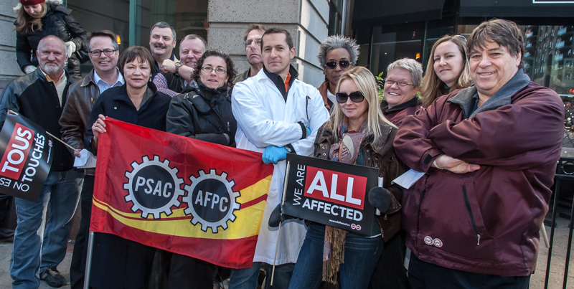
Federal inspectors
They are part of the Technical Services group consisting of about 11,000 workers
Some people in this group work as civil aviation, maritime transport, rail and hazardous substances inspectors

Slide 34

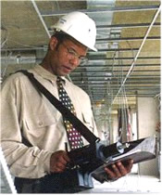
Federal inspectors
We collaborated with the Canadian Centre for Policy Alternatives to get a feel for our OHS members/inspectors.
We interviewed many LAOs one on one and in groups in 2010 and now in 2015.
We examined the challenges facing front-line LAOs required to apply the regulations.

Slide 35
Federal inspectors - 2015 Report
This CCPA study finds that the overall situation is now much worse. While certain injury indices for federally regulated workplaces have improved since 2007, the improvements are small compared to those at the provincial level.
The fatality rate has not really improved. In the 12 years, 2002-2013, for which we have figures: 684 employees died as a result of workplace injury (yearly average is 57 and remains unchanged).
The state of health and safety regulation cannot be measured simply by the latest statistics, as the 2013 Lac Mégantic derailment tragedy confirmed, but rather must include an assessment of the state of government regulation and the currency of inspections.

Slide 36
Federal inspectors - 2015 Report
Total number of employees working in the federally regulated sector:
2007 - 1,018,849 employees (full time equivalents or FTEs)
2012 - 1,173,165 employees (a growth of 15%)
At the same time, the number of inspectors has fallen sharply.
The Labour Program of Employment and Social Development Canada claims there are 90 inspectors today (and a recent federal budget promised to hire 10 more).
But CCPA reports that there are no more than 67 now working! The cut in absolute numbers of inspectors is between 28% and 46% since 2007, depending if one accepts 90 or 67 as the actual number of inspectors.

Slide 37
Federal inspectors - 2015 Report
The ratio of workers to inspectors at federally regulated industries has increased substantially.
8151 to 1 in 2007 (already high and unacceptable)
13,035 to 1 in 2015 (according to government figures)
This is a 60% increase in the number of workers per inspector
17,510 to 1 in 2015 (according to the departmental list)
This is a 115% increase in the number of workers per inspector

Slide 38

ISSUES
Lack of adequate inspection services (number, expertise, difficult retention and recruiting, etc.)
Little in the way of regular preventive intervention
Ad hoc intervention in response to complaints received often from resources borrowed from other regions

Slide 39
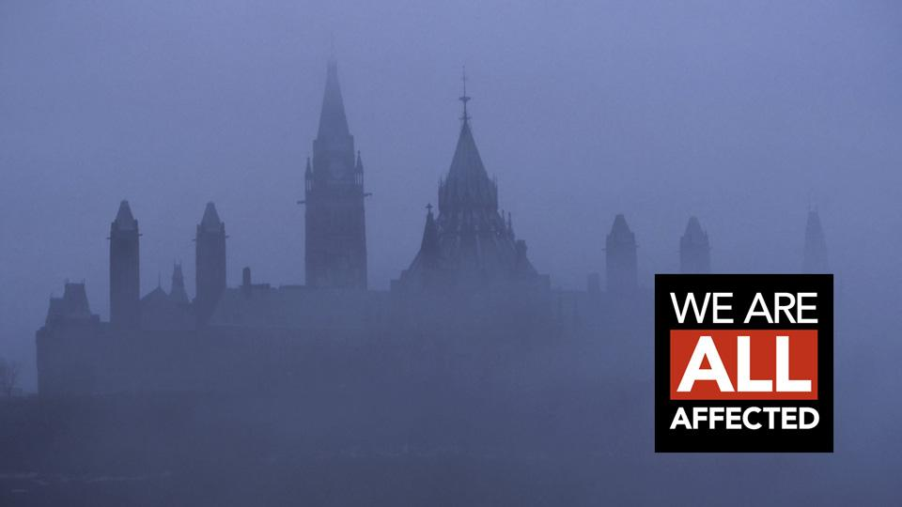
ISSUES
Few resources to follow up on cases
Government inspectors usually go along with promises of voluntary compliance
Few cases are conducive to prosecution

Slide 40

Federal inspectors
The LAOs are very concerned about their ability to do their jobs well.
They believe that management-related problems and undue interference in their work hinder them from guaranteeing worker safety.
As a result, workers in federal workplaces do not receive the level of protection they are entitled to under federal legislation.

Slide 41
Federal inspectors - 2015 Report Recommendations
1) The 2013 Bill C-4 Changes to the Canada Labour Code should be scrapped
2) Regular field inspections should be done in all workplaces, with high-risk workplaces especially targeted over a defined period of time. This should be combined with unadvertised blitzes on targeted industries

Slide 42
Federal inspectors - 2015 Report Recommendations
3) Staffing levels of Health and Safety Officers (HSO) must be increased and brought back to 2005 levels. In order to ensure an effective workplace health and safety inspection system, staffing levels need to return to 2005 levels when there were 151 field inspectors. (The present number is between 67 and 90.)
4) A new training program for all Health and Safety Officers should be introduced which would be modeled on aspects of the Ontario program which is a nine month program involving courses, practical training and examinations

Slide 43
Federal inspectors - 2015 Report Recommendations
5) Health and Safety Officer compensation levels should be commensurate with pay levels elsewhere in the federal government and with best performing provinces for the same kind of work.
6) Develop a strategy for workplace safety on First Nations reserves. In the last report it was noted that workplaces on First Nations reserves were not inspected on a regular basis and this remains true in 2015.

Slide 44
Federal inspectors - 2015 Report Recommendations
7) Develop a reliable and transparent statistical base on health and safety incidents and inspections for all federally regulated companies with a common identifier. This should include obligatory Employer reports with fines and penalties imposed on employers who do not report.
8) Make all Labour Program, Transport Canada and National Energy Board Health and Safety regulatory activities transparent and have indicators published on an annual basis.

Slide 45
Federal inspectors - 2015 Report Recommendations
9) Fire Protection Services at Labour Canada should be reinstated. In 2010 the federal fire inspectors which insured fire inspections in federal government departments, crown corporations and on Aboriginal reserves were eliminated with the last inspector job terminated in 2013.
10) Make all Parliament employees subject to the Canada Labour Code Part II.

Slide 46
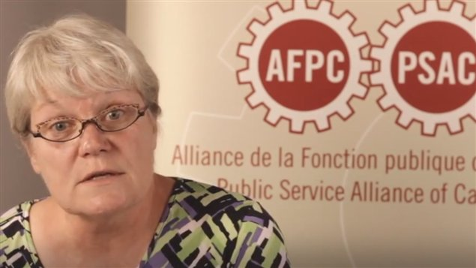
Federal inspectors
"Healthy and safe working conditions are the right of every worker and a scheme that strips those rights away and puts workers in harm’s way is, in a word, deadly".
Robyn Benson, National President of the Public Service Alliance of Canada.

