Slide 1
Occupational Health & Safety
Presentation at the Union of Taxation Employees National Health and Safety Conference
November 2015

Slide 2
Agenda
Overview of the OHS Program
Changes since Last Presentation
OHS Report Application (formerly Appendix A)
Hazardous Occurrence Investigation Report (T4009)
Bringing It All Together

Slide 3

Overview of the OHS Program

Slide 4
OHS Structure Following OHSAS 18001:2007 Standard
OHS Program
Plan
Do
Check
Act
OHS policy instruments
Identify hazards
Accident trends
Reporting
Establish improvement objectives
Develop & implement prevention programs
Establish roles and responsibilities
OHS communication
Monitor
Health and Safety Committees and Representatives

Slide 5
OHS Network Within the CRA
National OHS Section
Policy development;
National monitoring and reporting;
Manage NHSPC; and
Center of expertise in OHS.
National Health and Safety Policy Committee
Consultation forum for employer and employee representatives to meet, exchange information, discuss and consider national OHS issues within the CRA.

Slide 6
OHS Network Within the CRA (cont.)
Occupational Health and Safety officers:
Regional monitoring and reporting of OHS policies and prevention initiatives;
Support HSCs and HSRs; and
Regional OHS expertise.
Health and Safety committees
Consultation forum for employer and employee representatives to meet, exchange information, discuss and consider local OHS issues.
Health and Safety representatives
Evaluate and consider local OHS issues, make recommendations to local management and to communicate OHS issues and concerns to employees.

Slide 7

Changes since Last Presentation

Slide 8
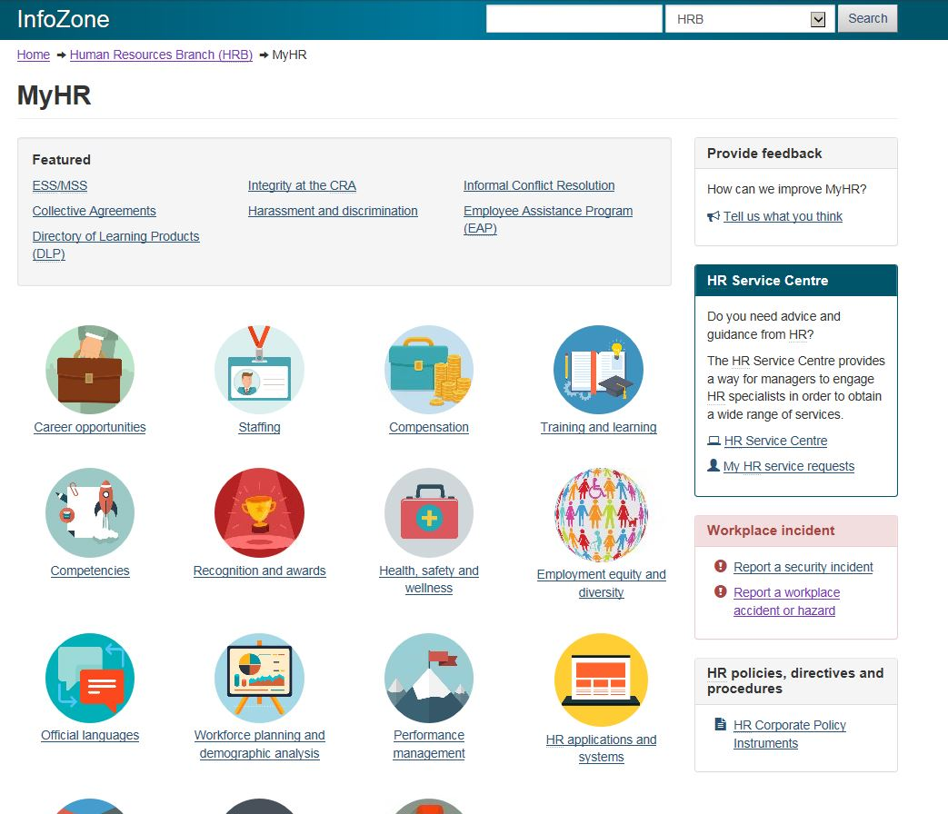
Modernizing HR

Slide 9
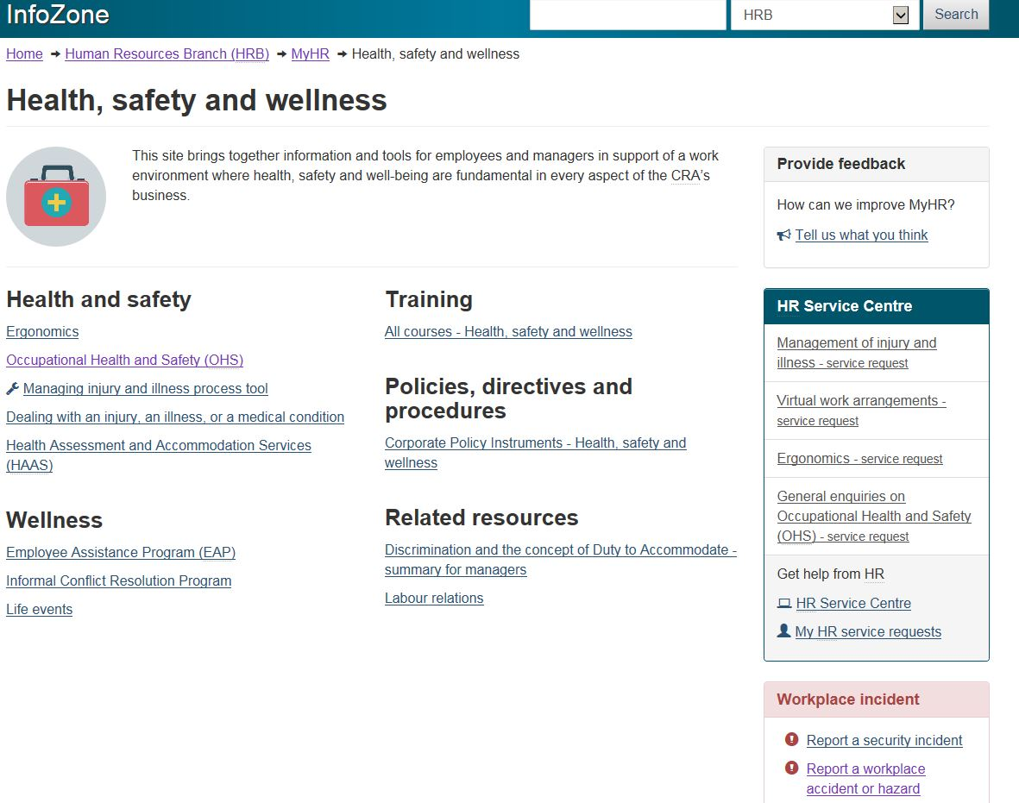
Modernizing HR (cont.)

Slide 10
Policy renewal and simplification
What is it?
We are reducing the overall number of corporate policy instruments and eliminating ineffective and unnecessary rules to lighten the administrative burden.
Why are we doing it?
To align with government priorities and ensure program and services remain relevant and effective.
When will it be done?
By April 2016

Slide 11
New OHS-related corporate policy instruments
SOP
Very similar to a procedure;
Clearly outlines the roles and responsibilities of the stakeholders; and
Sets out general instructions.
SWP
Short (typically one page) document that flows from a SOP;
Offers concise and detailed step-by-step instructions on how to complete a given task safely;
Outlines the training and the personal protective equipment (PPE) requirement;
Outlines what must not be done, all following a standard format.

Slide 12
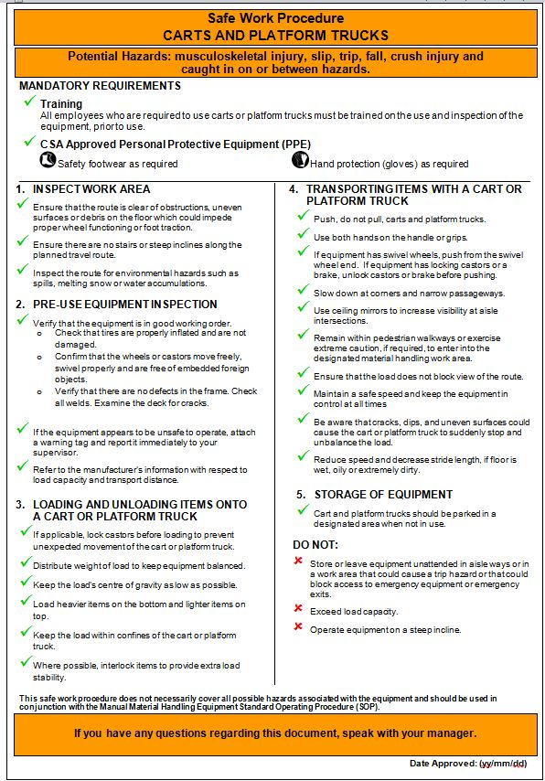
Safe Work Procedure
Notes:
1. Subject: Identifies the task that the safe work procedure applies to.
2. Potential Hazards: Informs the employee of the hazards related to the task.
3. Mandatory Requirements: Outlines what is required of an employee to complete the task.
4. Training: Indicates the training an employee must have before doing the task.
5. Personal protective equipment: Informs the employee what PPE is required to do the task.
6. Task instructions: Describes how a task is done in a step by step manner.
7. Do not: Informs the employee what must not be done.
8. Additional information: This area is for any additional information, including the SOP related to the SWP.
9. Administrative: Identifies the SWPs owner, approval and review dates.

Slide 13
Policy Review Working Group and MEJHA Working Group
Policy Review Working Group
Made of representatives from the National OHS Section and NHSPC.
To review the Agency’s policy instruments, with the mandate to streamline and update these documents to ensure OHS information is concise and available to the audiences who require it.
Multiple Environment Job Hazard Analysis Working Group
Made of representatives from each branch and the NHSPC, was established to address the need for clear procedures for employees working in high risk work environments.

Slide 14
Policy Review Working Group and MEJHA Working Group
Under the coordination of the National OHS Section, these Working Groups developed SOPs, SWPs, and guides which are clear, consistent and easy to follow.
They also support the functional manager in meeting their responsibilities related to the protection of employees in their work environments.

Slide 15
Policy Review
All Corporate Policy Instrument documentation for addressing the hazards identified as high risks has been completed by the Working Group.
Once the documentation is approved, the training phase will begin on all the SOPs and SWPs.

Slide 16
Standard Operating Procedures (SOP) Machinery, Equipment and Tools
Industrial Machinery and Equipment SOP
Abrasing cut-off and Dry-cut Machines
Hand and Power Tools SOP
Angle Grinder
Manual Material Handling Equipment SOP
Carts and Platform Trucks
Powered Lift Trucks SOP
Pre-start Inspection
Safe Lifting and Carrying Techniques Awareness
PLT Operating
PLT Load Handling
PLT Pallet Rack Storage
PLT Adjusting Forks
PLT Unloading a trailer
PLT Battery Charging
PLT Lockout/Tag out
PLT Hand Signal
PLT Emergency
PLT Hand Signal Guide
Pedestrians or employees working or walking in PLT Operating Area
PLT Travel with or without a load
PLT Battery Charger Lockout/Tag out
Motorized Pallet Jack
Assemble and Dissemble Monotainers
Band Saw
Bench Grinder
Box Cutters and Knives
Chop Saw
Circular Saw
Cordless Power Hand Tools
Drill Press
Hand Tools
Heat Gun
Jigsaw and Reciprocating Saw
Mitre Saw
Pneumatic Impact Wrenches Tool
Powered Hand Tool - Drills
Powered Hand Tools and Accessories
Radial Arm Saw
Router
Sanding Machine
Soldering Iron Pencil
Table Saw
Cardboard Compactor
Compressed Air Equipment
Industrial Printer
Industrial Shredder
Inserter
Machinery and Equipment Safety
Mobile Shelving Unit
Opex 150 Mail Extraction Machine
Opex 51 Mail Extraction Machine
Opex MPS 30 Sorter Machine
X Series Transport Machine
Conveyors
Hand Truck
High Lift Pallet Jack
Ladders
Manual Pallet Jack

Slide 17
Standard Operating Procedures (cont.) Safety, Housekeeping and Storage
Loading Dock SOP
Office Ergonomics SOP
Office Ergonomics Tools
Personal Protective Equipment and Clothing SOP
Personal Protective Equipment and Clothing Selection Guide
Driver Safety SOP
Driver Safety Guide
Dock Leveller
Personal Protective Equipment Tools
875 Heron Lower Loading Dock
Protective Footwear Assessment Tool
CRA ITB/CBSA Traffic Lanes SOP
CRA ITB/CBSA Traffic Lanes

Slide 18
Standard Operating Procedures (cont.) Program Oversight
HSC/HSR SOP
Supporting Annexes
First Aid and AED SOP
SWP
Work Place Inspection SOP
Work Place Inspection Guide
Working with ESDC HSOs SOP
Hazardous Substances SOP
In development
Terms of Reference Guide and Template
Includes On-Site Visit Process
First Aid/AED Tool

Slide 19
Hazardous Substances Review
A full review of all hazardous substances used by employees in the course of their work is ongoing.
Once completed, a database of all approved products will be developed and posted on InfoZone.
In addition, we are reviewing the existing Hazardous Substances Policy and will update it to develop a Hazardous Substances SOP.
It will be aligned with the new Globally Harmonized System (GHS), also known as WHMIS 2015, requirements.

Slide 20
Health and Safety Committees and Representatives SOP
Appendix | Document Title | Audience
A | Establishing a Health and Safety Organizational Structure at a New Location | Most senior management representative on-site (MSMRO)
B | Health and Safety Committee and Representatives Membership | MSMRO, HSC, HSR
C | Multiple Work Place Committees | MSMRO, HSC
D | Setting up a New Health and Safety Committee | HSC
E | Terms of Reference and Guide | HSC
F | Health and Safety Representative | HSR
G | HSC Annual Report to Management | HSC
H | HSR Annual Report to Management | HSR
I | Management of Records | MSMRO, HSC, HSR

Slide 21
What does this mean for your HSC?
These documents must be easily accessible to every employee that does the related task, such as visibly posted on a wall near where the task is completed.
Your HSC should make sure that employees and managers are aware of SOPs and SWPs.
When conducting inspections, your HSC can monitor activities against the SWP to make sure tasks are being conducted safely.

Slide 22

OHS Report Application

Slide 23

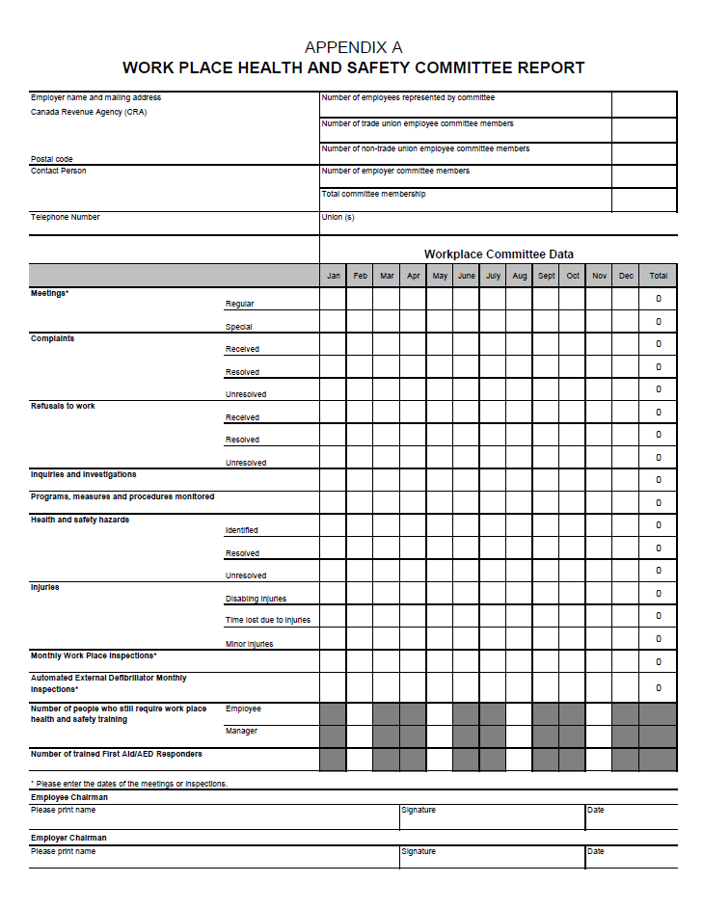
Appendix “A” Documents
Previously, HSC provided statistics using an Excel document which was completed monthly and submitted to the National OHS Inbox.
The National OHS Section would manually gather the data to generate the semi-annual and annual Scorecards.

Slide 24
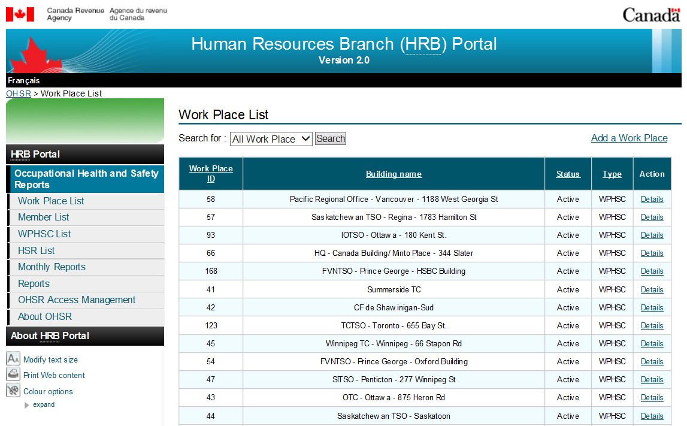
OHSR Portal

Slide 25
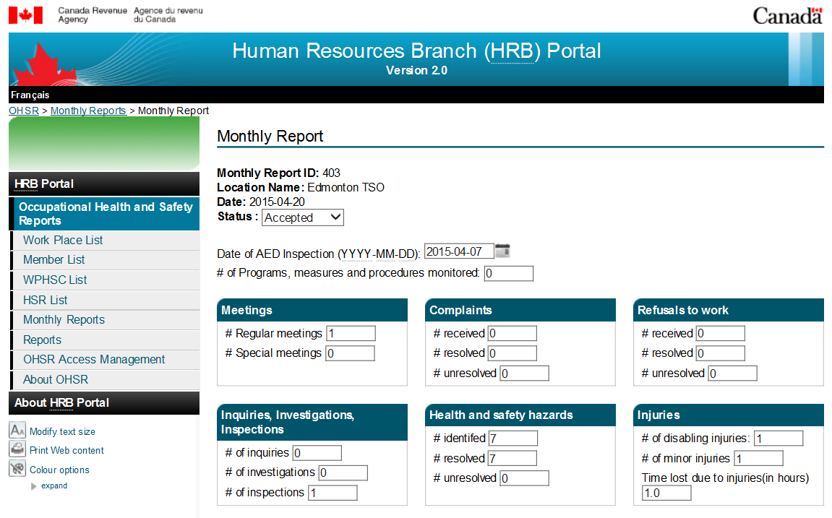
Monthly Reports

Slide 26
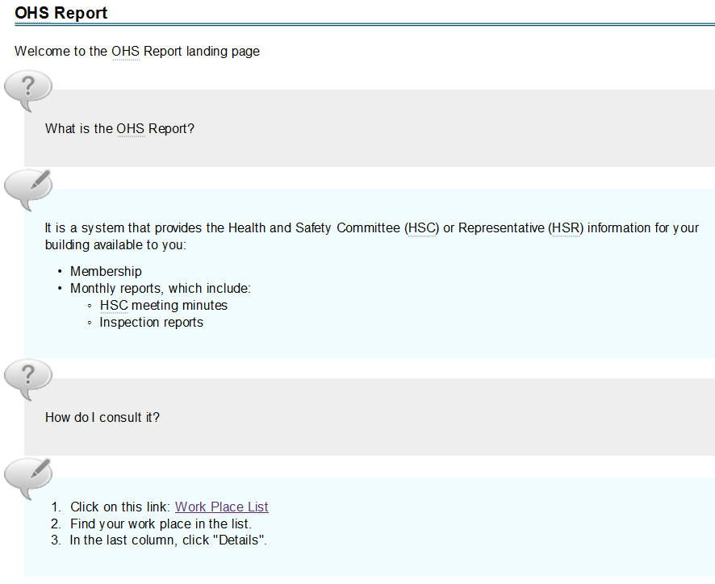
Meeting Minutes
Non-committee members may then easily view member details, meeting minutes and inspections by following the links provided on InfoZone.

Slide 27

Hazardous Occurrence Investigation Report (T4009)

Slide 28
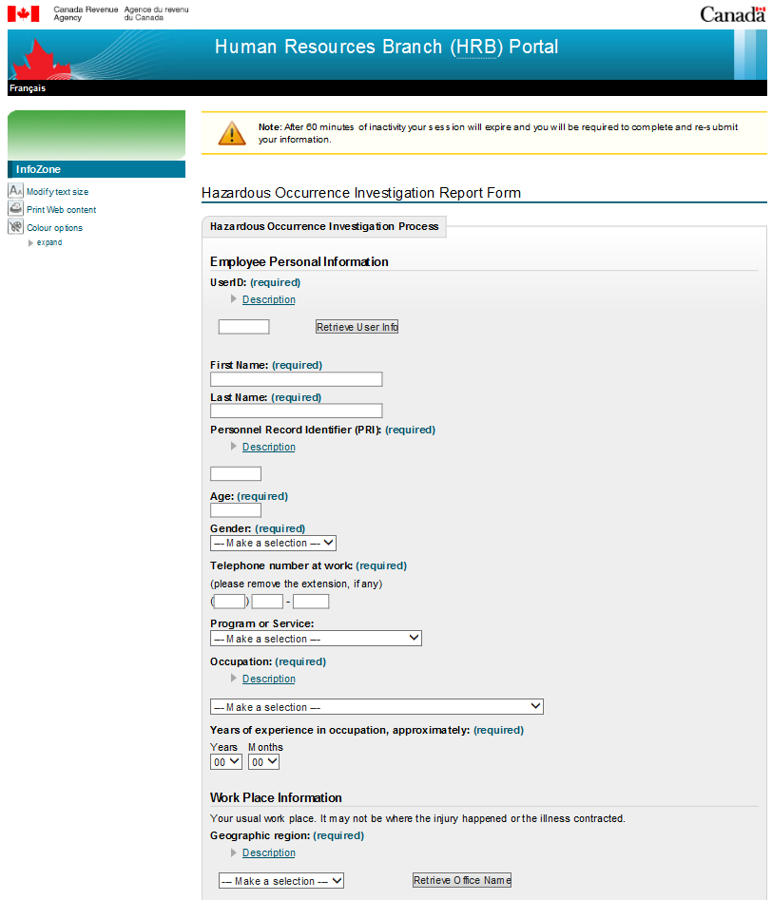
T4009 – Hazard Reporting
Previously, hazards and incidents were reported via paper copies of the T4009.
The new online report allows for instant notification, easy updates,as well as improved tracking.
There are two different types of T4009 reports…

Slide 29
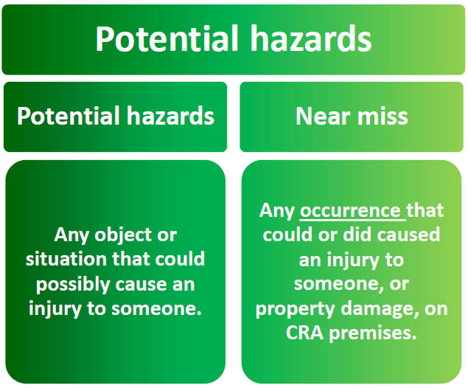
T4009 - Potential Hazard Investigation Report

Slide 30
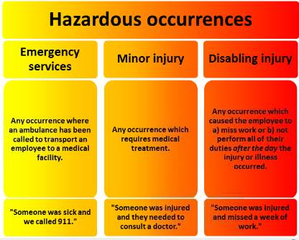
T4009 - Hazardous Occurrence Investigation Report

Slide 31
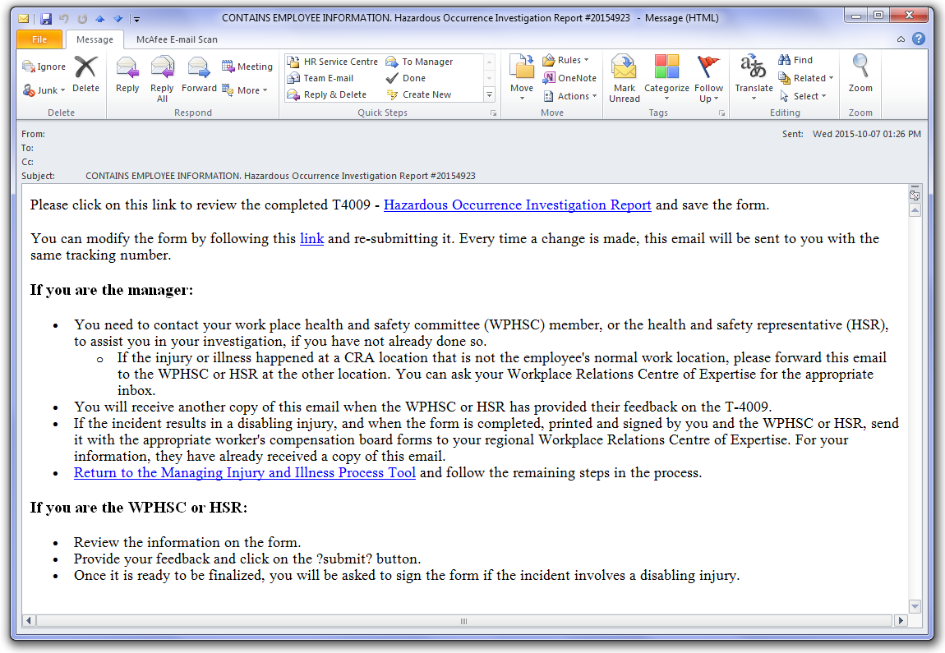
T4009 - Notification

Slide 32
T4009 and Work Place Violence
If you have experienced an injury related to workplace violence, please contact the National Occupational Health and Safety inbox to receive an off-line version of the form to complete.
Details should focus on the injury and avoid description of the actual workplace violence situation in order to protect the confidentiality of the parties involved.

Slide 33

Bringing It All Together

Slide 34
The Big Picture
Supporting HSCs/HSRs
SOPs and SWPs
T4009
Training
Inspections
Recommendation Form
Newsletter
OHSR
Terms of Reference
OHS Website
Information Bulletins

Slide 35
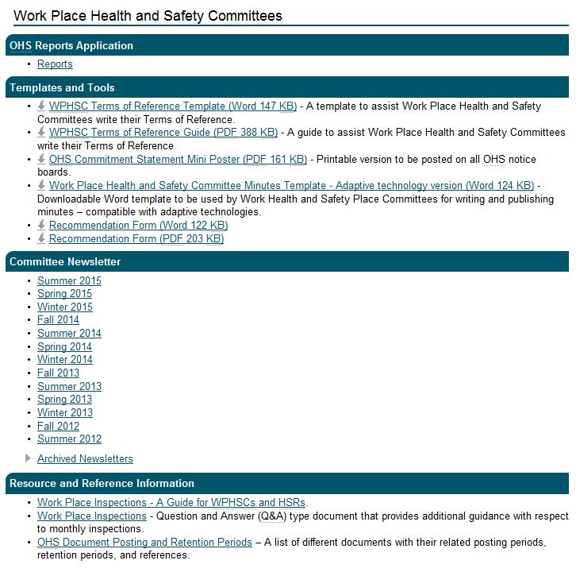
Resources and Tools

Slide 36

What role can the Health & Safety Committee and Representative play?
Have proactive discussions on the control of hazards in the workplace
Workplace inspections and participate in OHS investigations
Provide employees with information on OHS topics (NAOSH week, etc.)
Provide recommendations to management
Discuss local employee health and safety concerns
Participate in OHS Program monitoring & stay connected to other HSCs
Link in with Ergonomic Coaches, First Aid/AED Coordinators/Responders and Building Emergency Organization

Slide 37

It’s lots of work, but…

Slide 38

Questions?

