Slide 1

Supporting Mental Health in the Federal Public Service: Taking Action
Presentation to the Union of Taxation Employees
National Health and Safety Conference
October 12, 2018

Slide 2

Situational Context: Setting the Stage
…to address mental health in the workplace…
The Government of Canada and the Public Service Alliance of Canada established a Joint Task Force to address mental health in the workplace.
The Clerk of the Privy Council placed mental health at the top of the management agenda, and convened an advisory group with internal and external stakeholders to discuss mental health.
Building from their work, in June 2016, the Federal Public Service Workplace Mental Health Strategy was released.
… to build a healthy, respectful, and supportive work environment that strengthens the public service

Slide 3
Situational Context: Joint Task Force
First report
September 2015
Third report
January 2018
Recommendations on leadership, engagement, education, training and workplace practices, communication and promotion, and measurement and accountability
Step-by-step roadmap that will help organizations identify and assess workplace hazards that can affect the psychological health and safety of employees
Second report
APRIL 2016
enterprise-wide and organization-specific key findings and actions

Slide 4
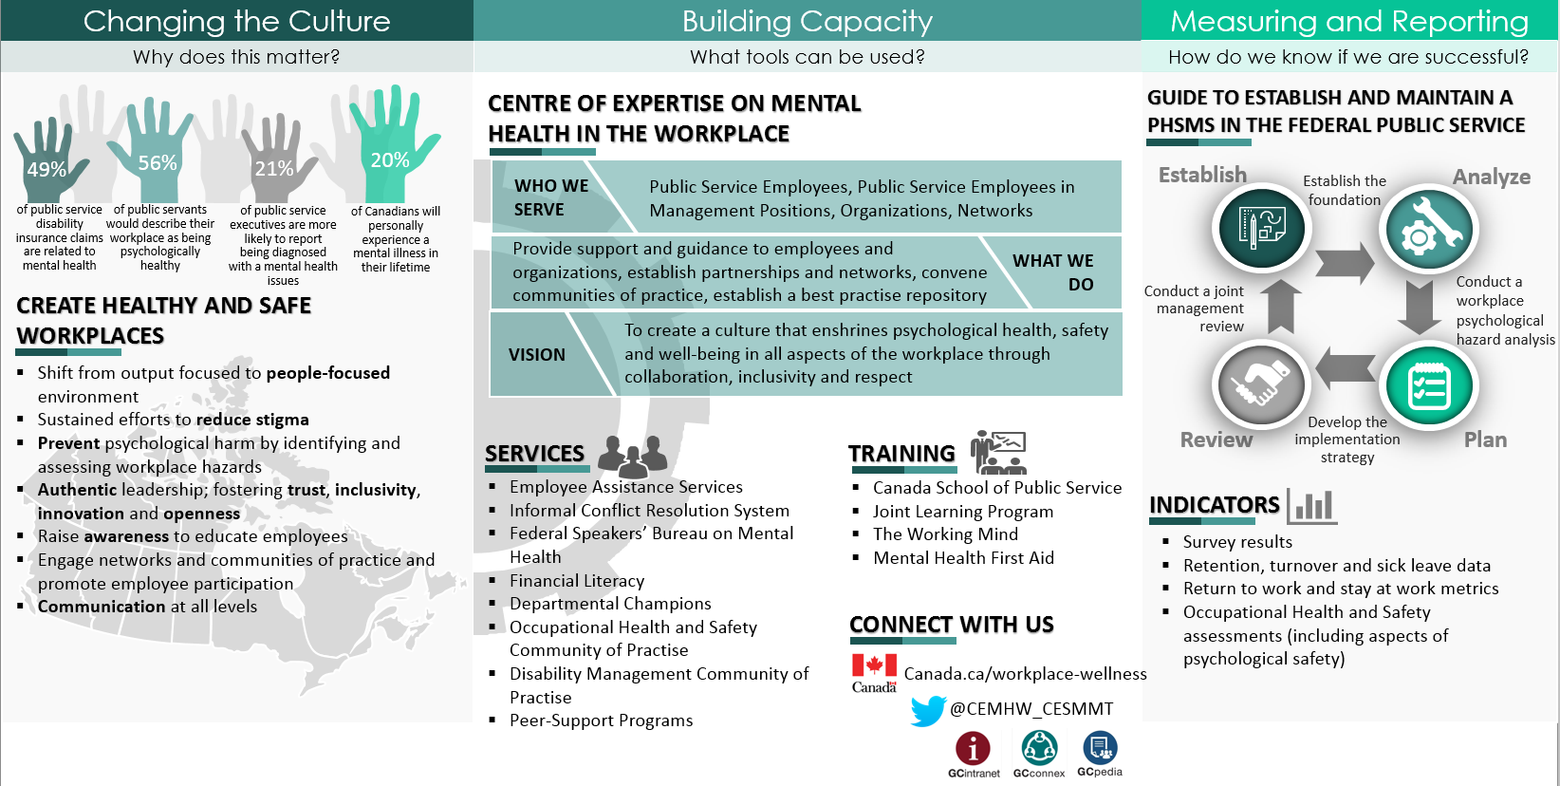
Mental Health in the Federal Public Service: The Strategy

Slide 5
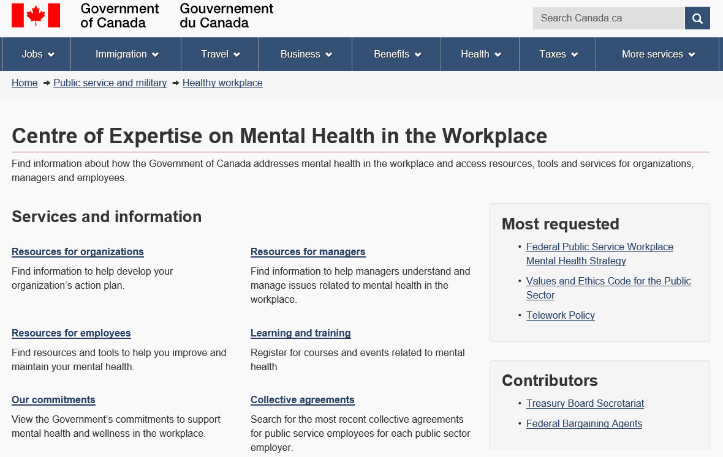


Canada.ca/workplace-wellness

Slide 6
Centre of Expertise in Numbers
32,523
Total Web Visits
in FY 2017-18
5.14 min.
Average time on site
65,620
Total Web Page Views
in FY 2017-18
1,800+
GCconnex members
1,300+
Twitter followers
70+
Mental Health and Wellness Champions
“While Let’s Talk Day is over, the need for conversations on #MentalHealth in our workplaces doesn’t end. Keep the dialogue going with these resources from @CEMHW_CESMMT: http://ow.ly/9W4X30i8D2X. #MentalHealthMatters #Get Loud”
@_RonParker
President, Shared Services Canada

Slide 7





Annexe A: Connect With Us
 | Visit Canada.ca/workplace-wellness to find resources, tools and services for organizations, managers and employees on any device, including computers, tablets and smart phones.
 | Visit GCintranet Mental Health in the Workplace for additional resources, tools and services, only available to public servants.
 | Join the Mental Health Strategy Group on GCconnex to participate in discussions, share information, and leverage the power of networking towards a more effective and efficient public service.
 | Visit the GCpedia page to find multimedia tools and resources that can be tailored to your own organization’s realities, challenges and environment.
@CEMHW_CESMMT | Follow us @CEMHW_CESMMT to learn about the latest Government of Canada news, events, developments and activities relating to mental health and psychological health and safety in the workplace.
Questions or comments can be sent to mhstrategy@tbs-sct.gc.ca

Slide 8
Contact Information
Denis St-Jean
Union Co-Chair of the Centre of Expertise on Mental Health in the Workplace
Treasury Board of Canada Secretariat
Government of Canada
Denis.St-Jean@TBS-SCT.gc.ca
Tel.: 343-548-5273
Jean-François Claude, M.S.M.
Employer Co-Chair of the Centre of Expertise on Mental Health in the Workplace
Treasury Board of Canada Secretariat
Government of Canada
Jean-Francois.Claude@TBS-SCT.gc.ca
Tel.: 613-404-1065

